Slide 1
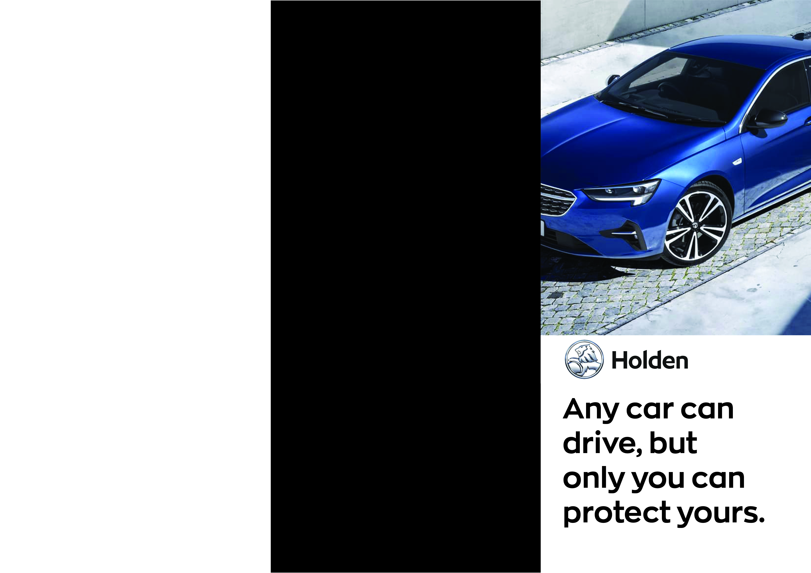
Individual Protection Pricing
HYDRO Surface Coating $1,190
HYDRO Leather Coating $695
HYDRO Vinyl Coating $695
HYDRO Fabric & Carpet Coating $695
Window Film $495
StreetLegal Window Film $595
Cancer Council Endorsed Window Film $654

Slide 2

Intro Pack
Protection Pack
Complete Pack
HYDRO Surface Coating
+
Window Film
Surface Coating
Vinyl Conditioner
Leather Protection
Fabric & Carpet Protector
Surface Coating
Vinyl Conditioner
Leather Protection
Fabric & Carpet Protector
+
Window Film
$1490
$1795
$1995
Insert contact details

