Slide 1
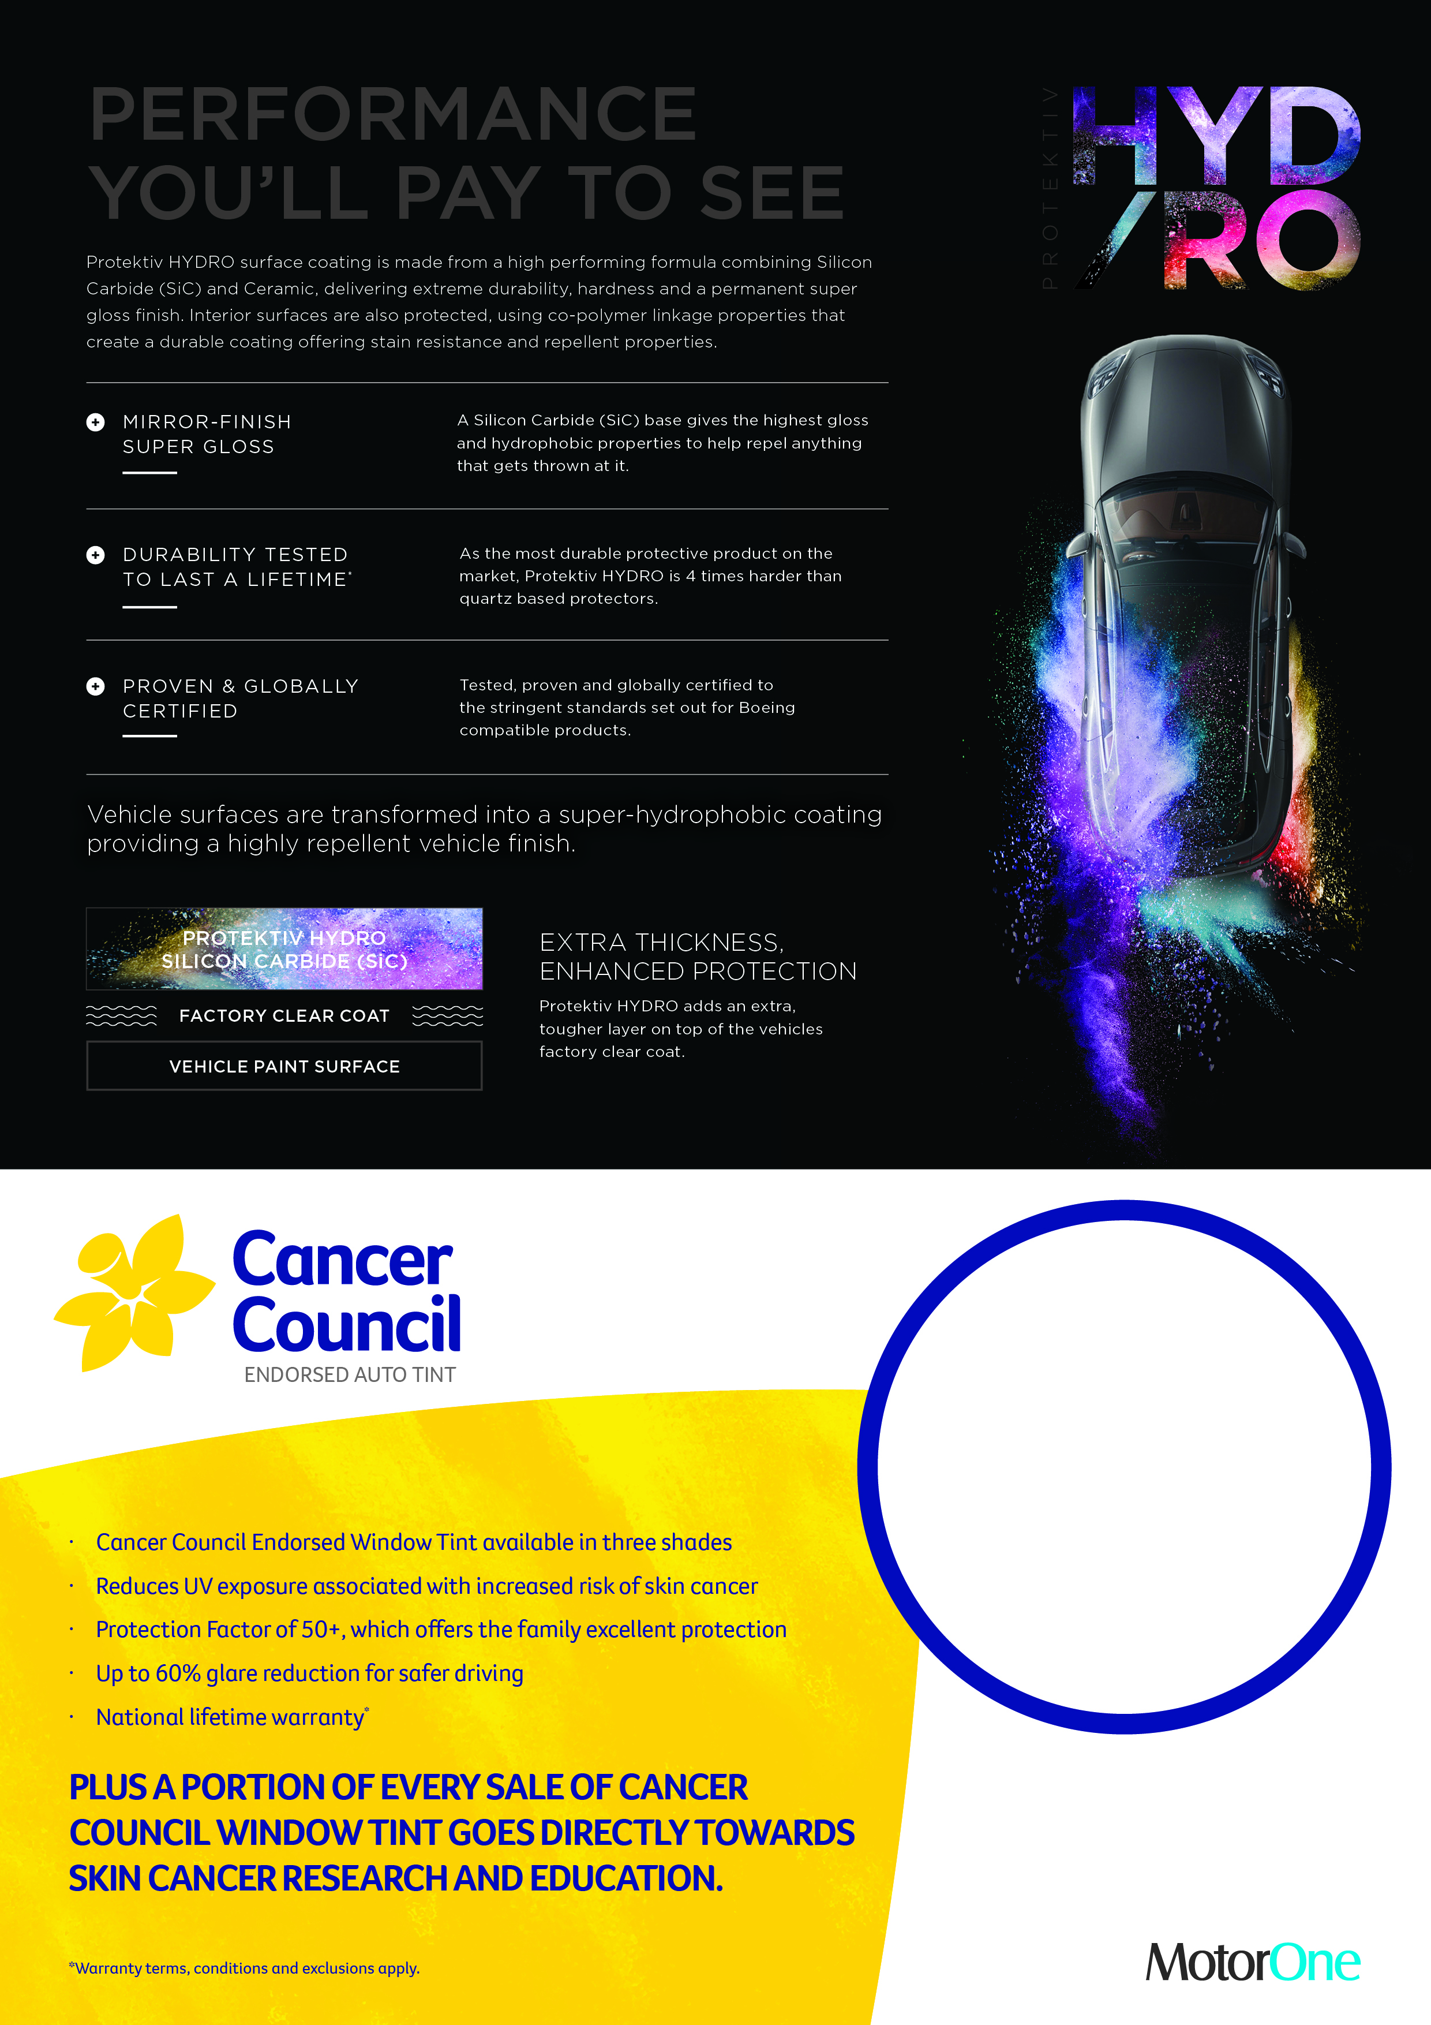
Get HYDRO +
Cancer Council Auto Tint
FOR ONLY
$XXX
Dealership Contact Details

