Slide 1
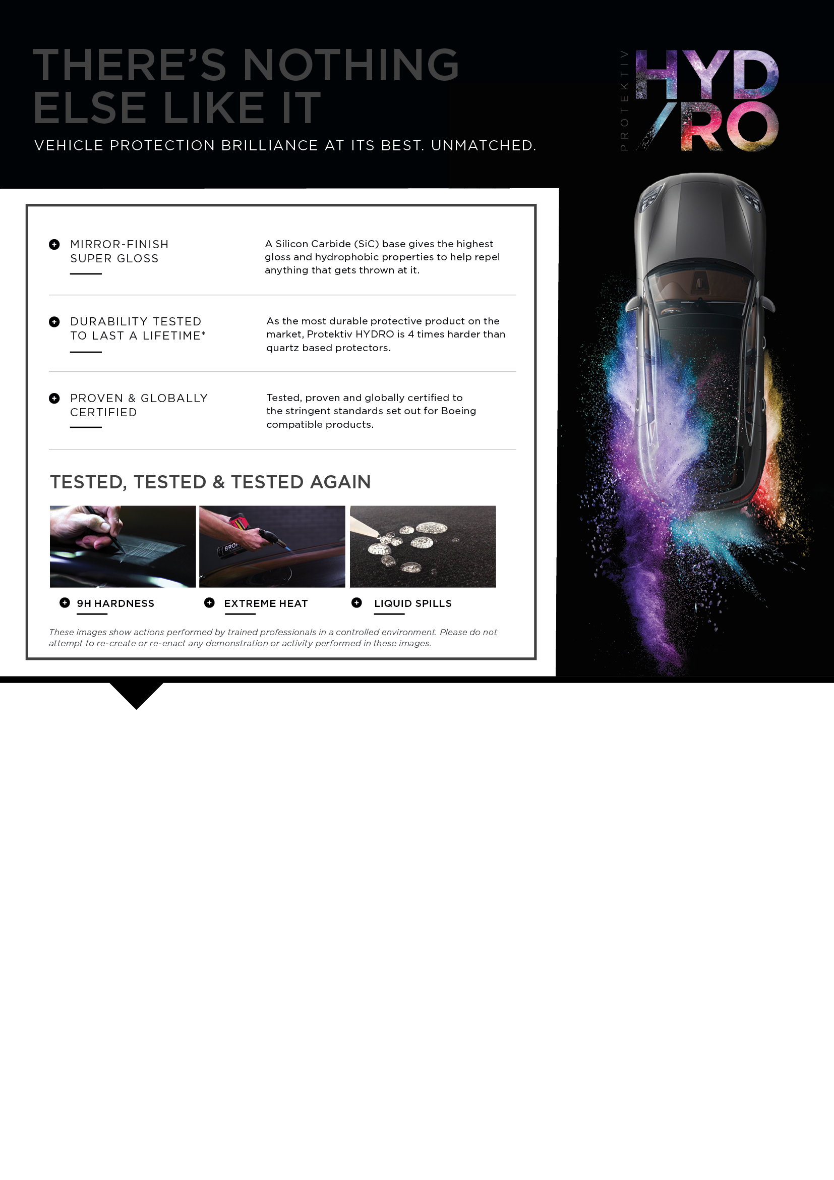
ALL-ROUND PROTECTION PACK
Protektiv HYDRO Paint Surface Coating
Protektiv HYDRO Complete Interior Coating
5 Year Schmick Scratch & Dent Assist Membership
+ FREE GIFT: Window Film
valued at $xxx
ONLY $xxxx | SAVE $XXX
ESSENTIALS PACK
Protektiv HYDRO Paint Surface Coating
Protektiv HYDRO Complete Interior Coating
+ FREE GIFT: 5 Year Schmick
Scratch & Dent Assist Membership
valued at $xxx
ONLY $xxxx | SAVE $XXX
BUT HURRY, THESE OFFERS ARE ONLY AVAILABLE ON [DAY/DATE]!
TALK TO OUR AFTERMARKET CONSULTANT
ABOUT THE SAVINGS ON THESE DEALS!
[INSERT CONSULTANT’S NAME
AND PHONE NUMBER]

Slide 2
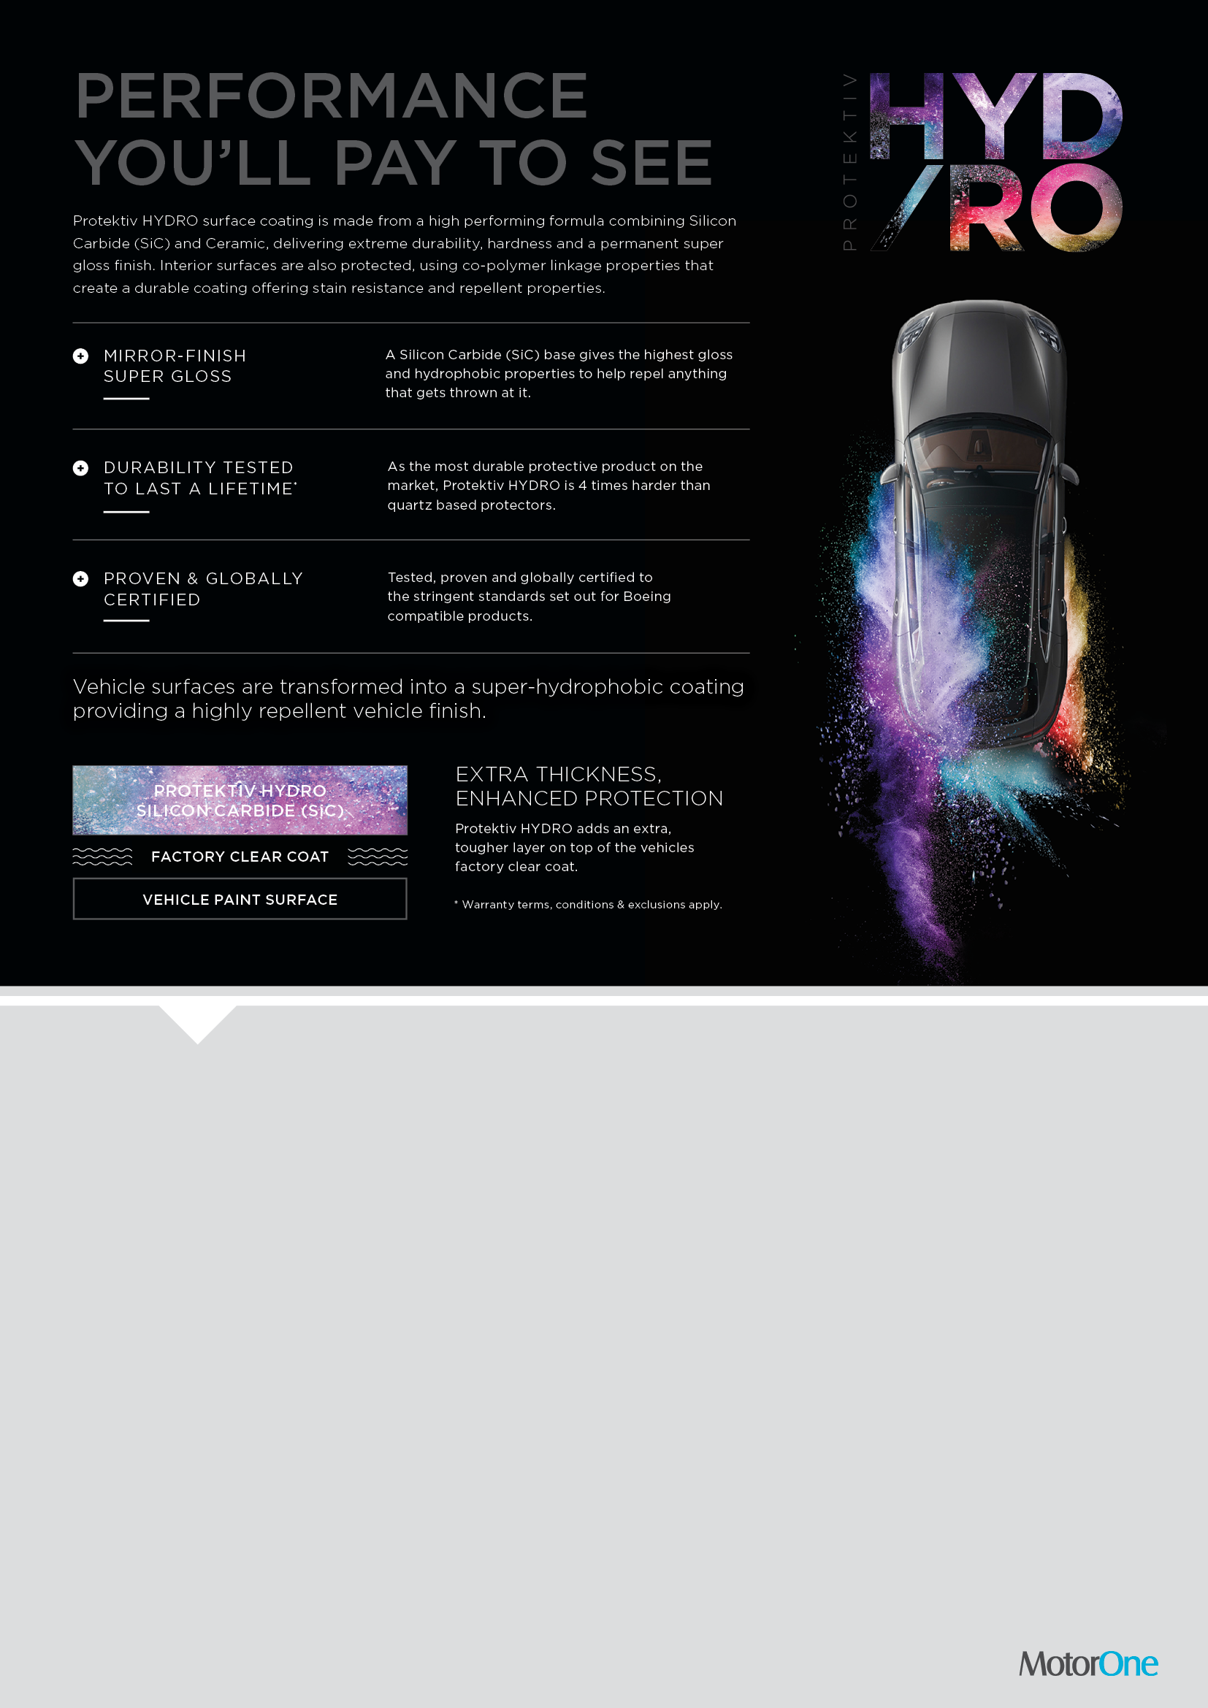
To celebrate our annual event, we’re offering package deals on vehicle protection products for your new vehicle.
PLATINUM PACK
Protektiv HYDRO
Paint Surface Coating
+
Protektiv HYDRO
Complete Interior Coating
+
5 Year Schmick Scratch & Dent Assist Membership
+
FREE GIFT:
Window Film valued at $xxx
ONLY $xxxx
GOLD PACK
Protektiv HYDRO
Paint Surface Coating
+
Protektiv HYDRO
Complete Interior Coating
+
FREE GIFT:
Choose from either
Window Film
valued at $xxx
or
5 Year Schmick Scratch & Dent Assist Membership
valued at $xxx
ONLY $xxxx
SILVER PACK
Protektiv HYDRO
Paint Surface Coating
or
Protektiv HYDRO
Complete Interior Coating
+
FREE
Window Film
valued at $xxx
ONLY $xxxx
Dealership Contact Details

