Slide 1
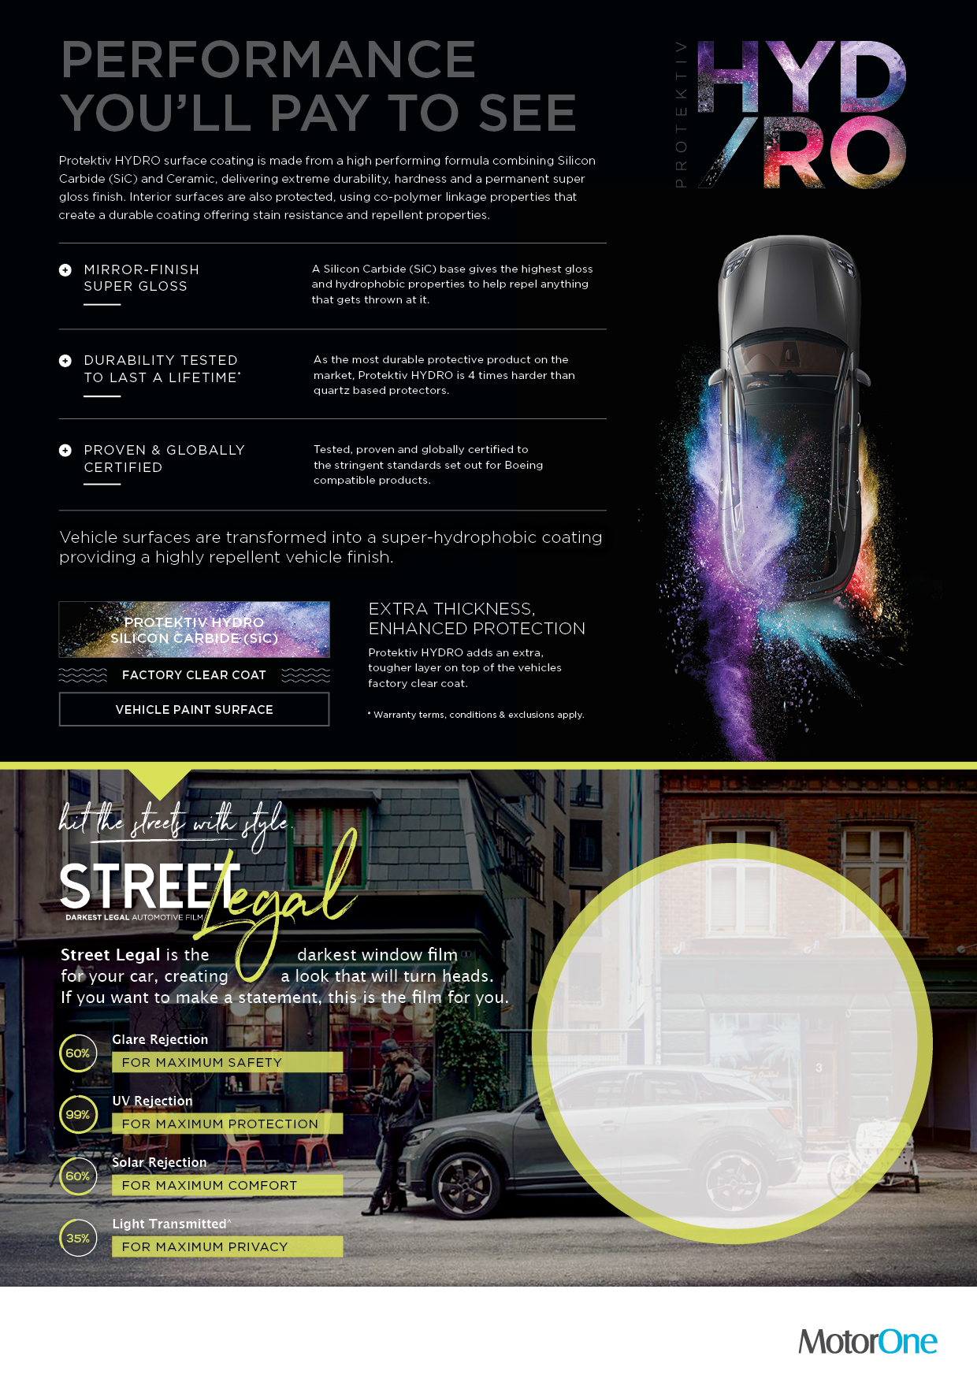
Get HYDRO +
Street Legal Tint
FOR ONLY
$XXX
Dealership Contact Details

