Slide 1
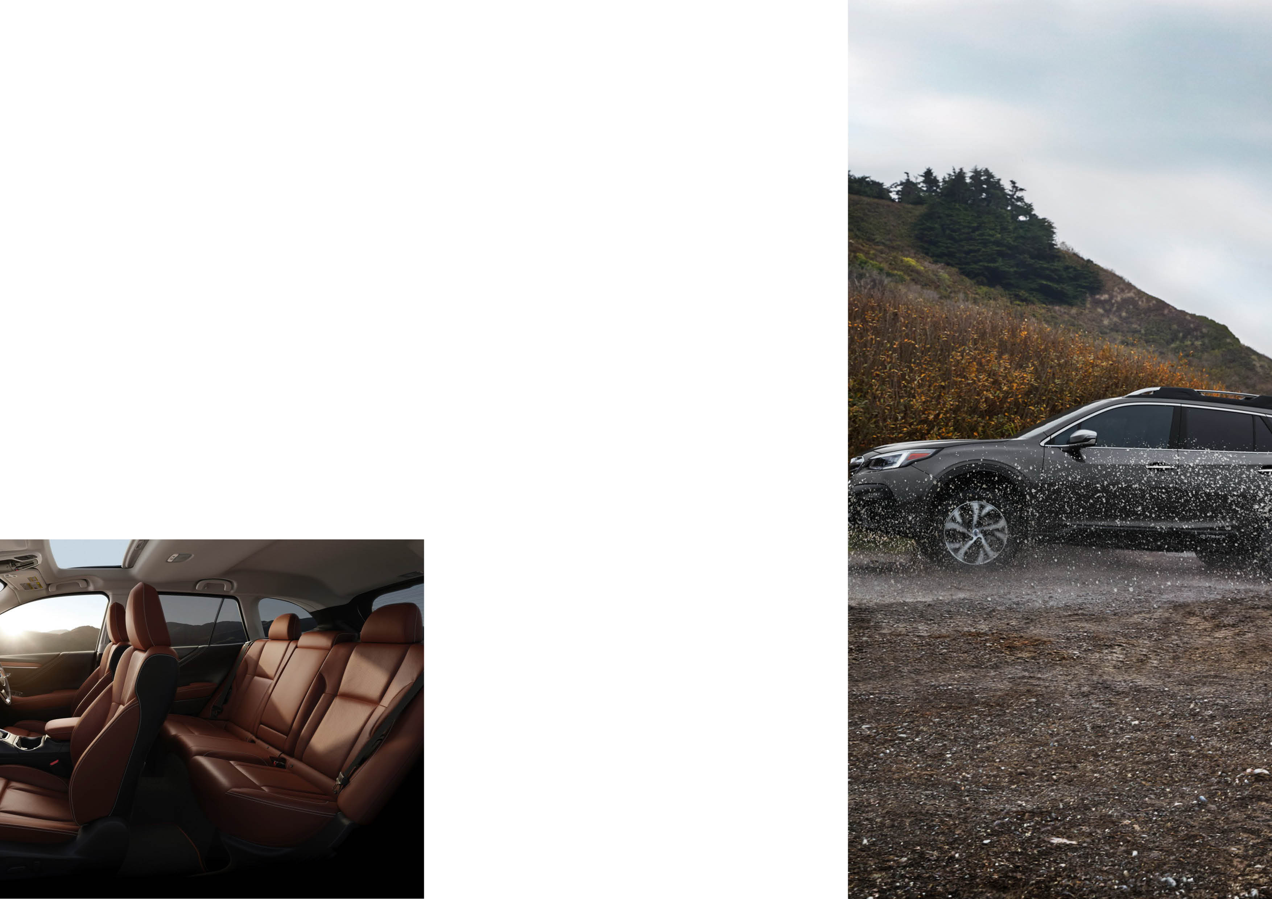

INDIVIDUAL PROTECTION PRICING
HYDRO Surface Coating $1,190
HYDRO Leather Coating $695
HYDRO Vinyl Coating $695
HYDRO Fabric & Carpet Coating $695
Window Film $495
StreetLegal Window Film $595
Cancer Council Endorsed Window Film $654
Insert dealer name
DISCOVER YOUR PROTECTION PACKAGE
Insert contact details

Slide 2

INTRO PACK
PROTECTION PACK
COMPLETE PACK
HYDRO Surface Coating
+
Window Film
Surface Coating
Vinyl Conditioner
Leather Protection
Fabric & Carpet Protector
Surface Coating
Vinyl Conditioner
Leather Protection
Fabric & Carpet Protector
+
Window Film
$1490
$1795
$1995

