Slide 1
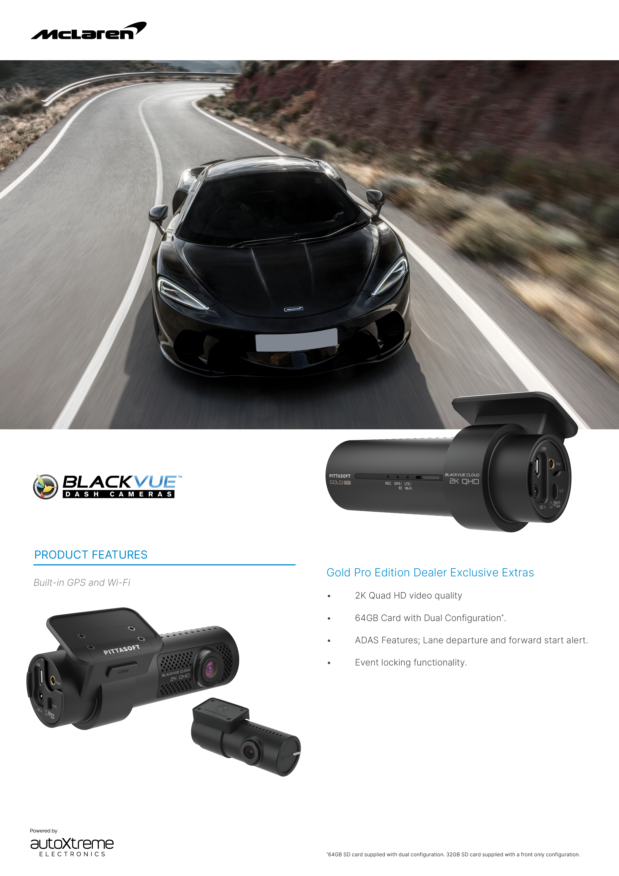
BlackVue Gold Pro - Special Offer
$xxx
SAVE FOR $XXX

