Slide 1
Protektiv HYDRO Surface Coating $x,xxx
Protektiv HYDRO Surface Coating $xxx
Protektiv HYDRO Surface Coating $xxx
Protektiv HYDRO Surface Coating $xxx
Window Film $xxx
Electronic Rust Protection $xxx
Canbus Alarm $xxx
Reverse Sensors $xxx
Front Sensors $xxx
Headrest DVD Player $xxx
Roof Mounted DVD Player $xxx
Reverse Camera $xxx

Slide 2
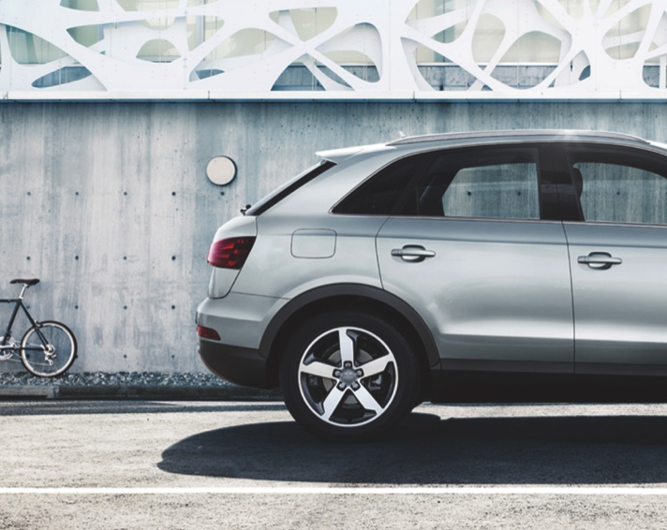
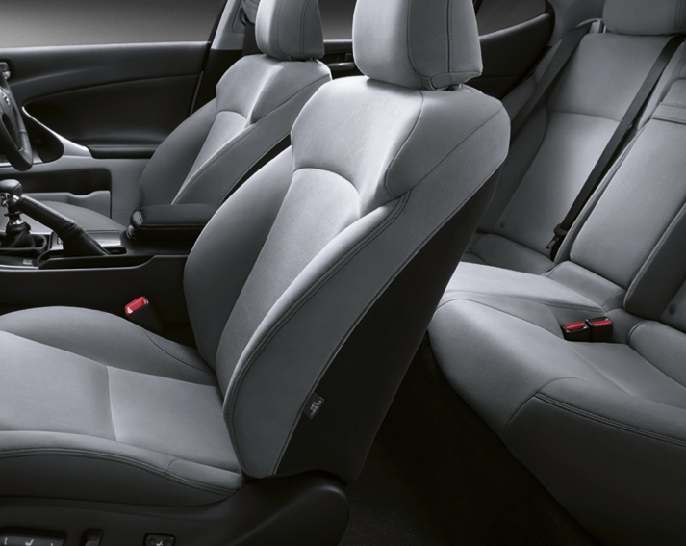
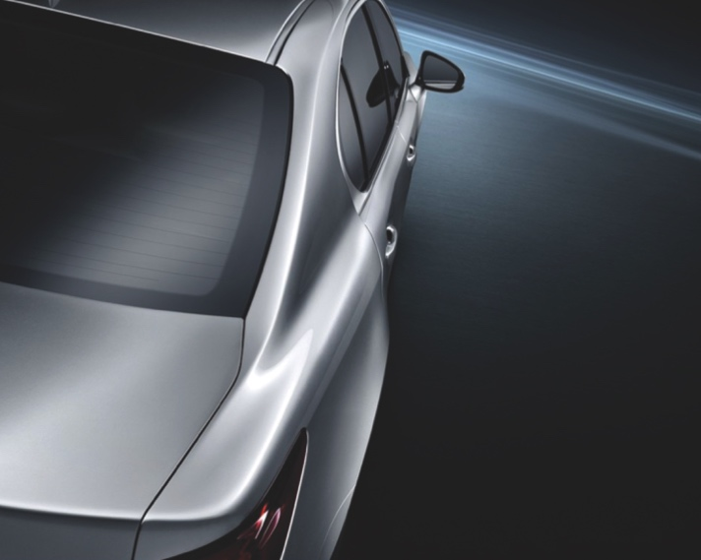
PACK 1
PACK 2
PACK 3
PREMIUM PACK
ULTIMATE PACK
TWO WAY PACK
Insert Products here
Insert Products here
Insert Products here
Insert Products here
Insert Products here
Insert Products here
Insert Products here
Insert Products here
Insert Products here
Insert Products here
Insert Products here
Insert Products here
Insert Products here
Insert Products here
Insert Products here
YOURS FOR JUST $XXXX
YOURS FOR JUST $XXXX
YOURS FOR JUST $XXXX

