Slide 1

Insert deal logo here

Slide 2
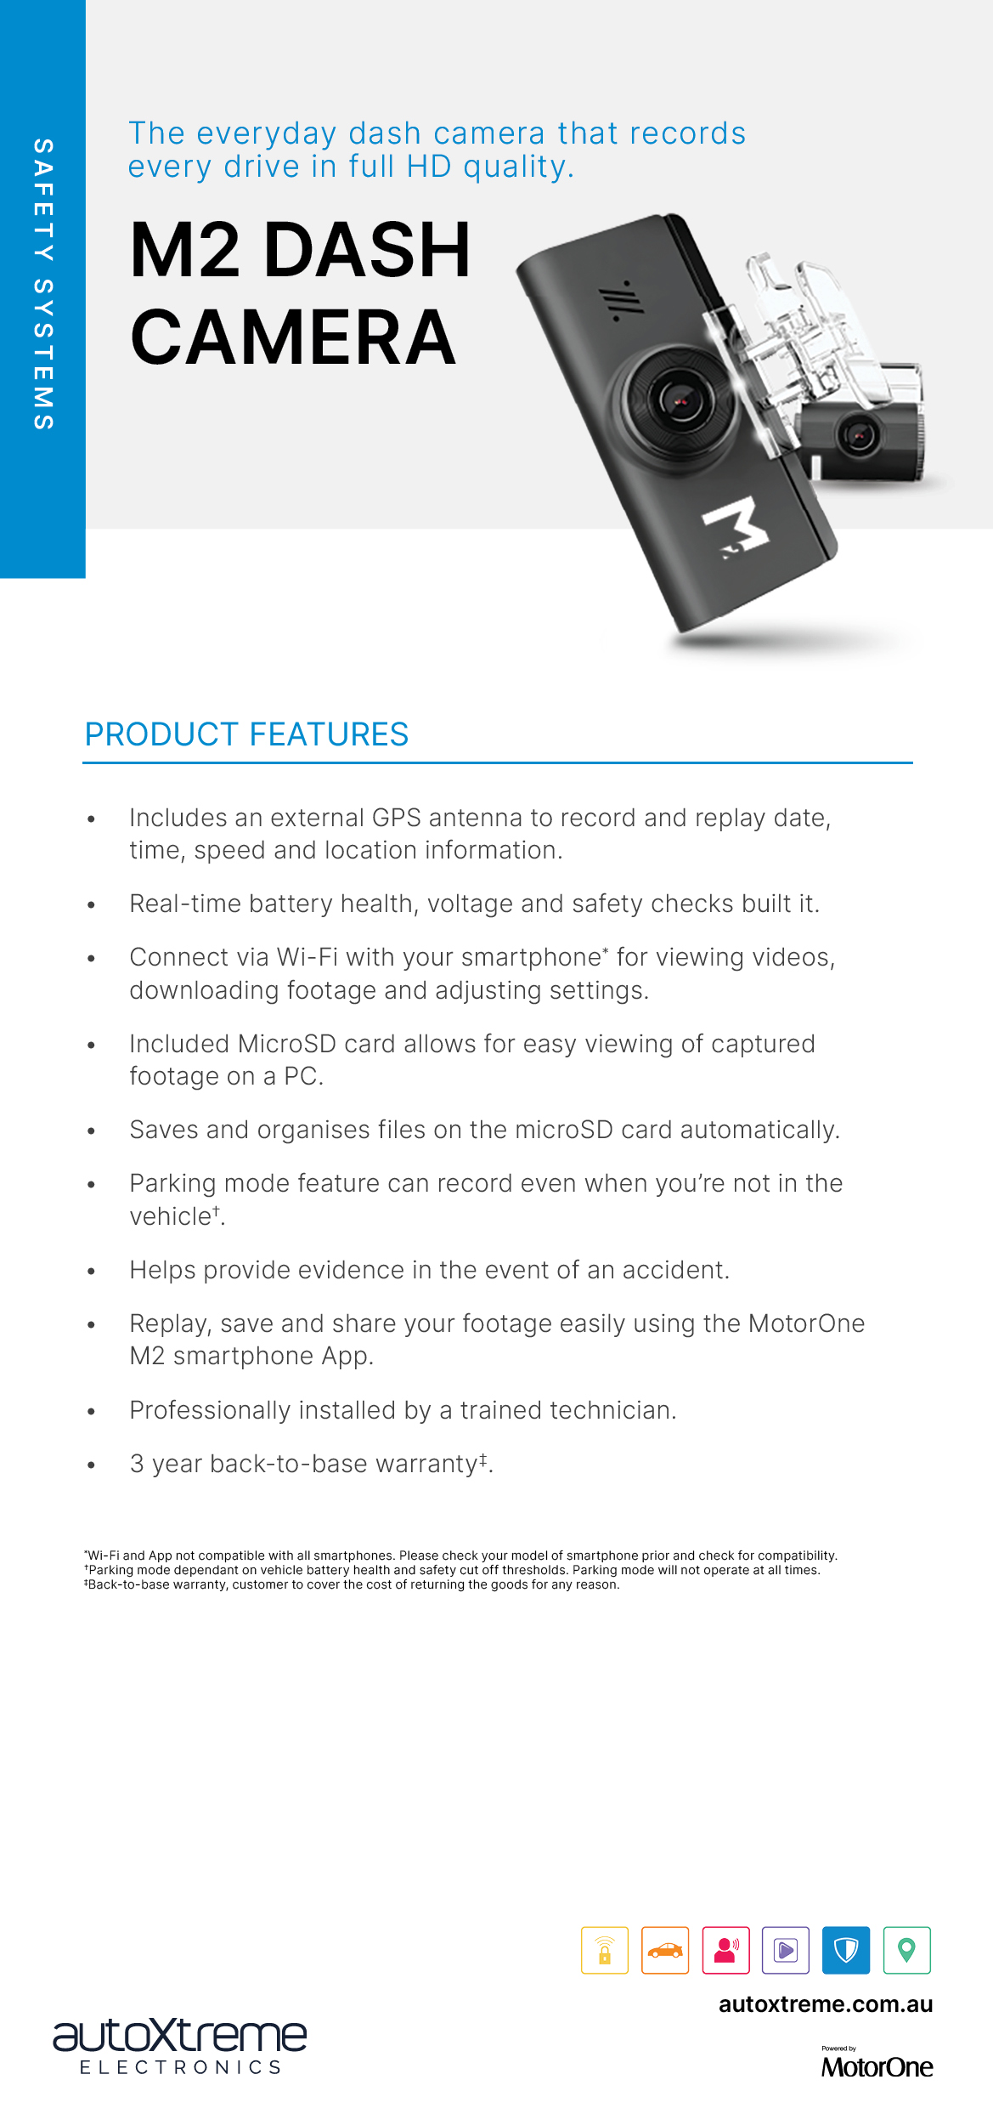
Insert dealer contact information here

