Slide 1
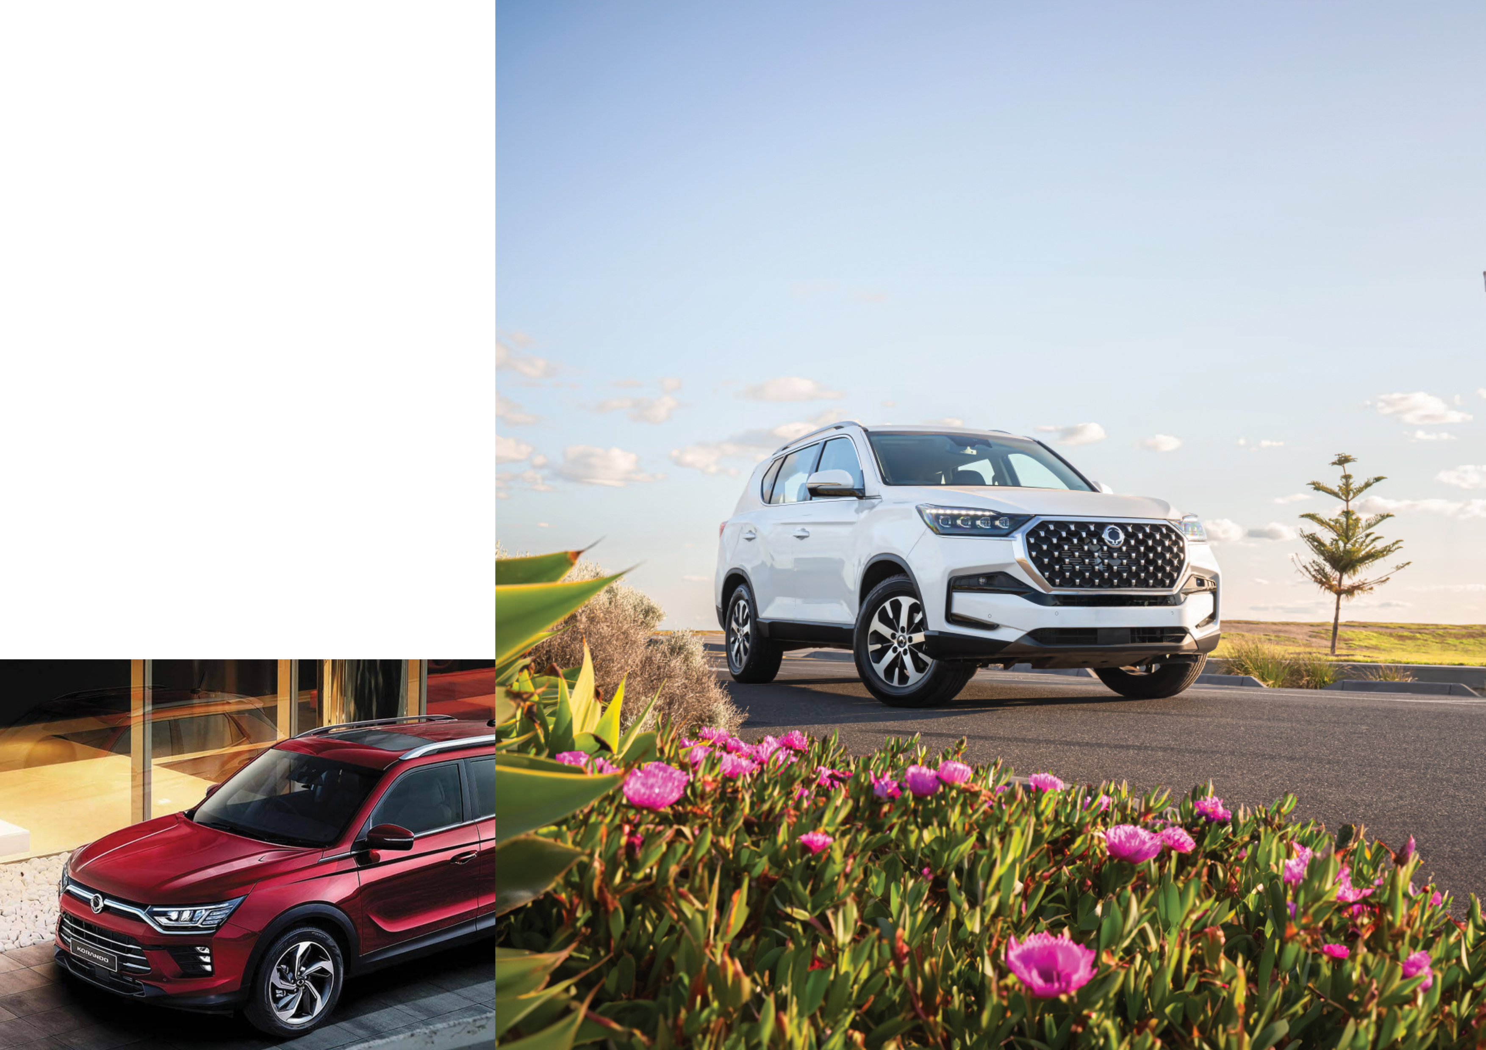
Individual Protection Pricing
SsangYong
Drive Long With Your Protection Package.
HYDRO Surface Coating $XXX
HYDRO Leather Coating $XXX
HYDRO Vinyl Coating $XXX
HYDRO Fabric & Carpet Coating $XXX
Window Film $XXX
Schmick X Year Membership $XXX
XX Dash Camera $XXX
Insert dealer name
Insert contact details

Slide 2
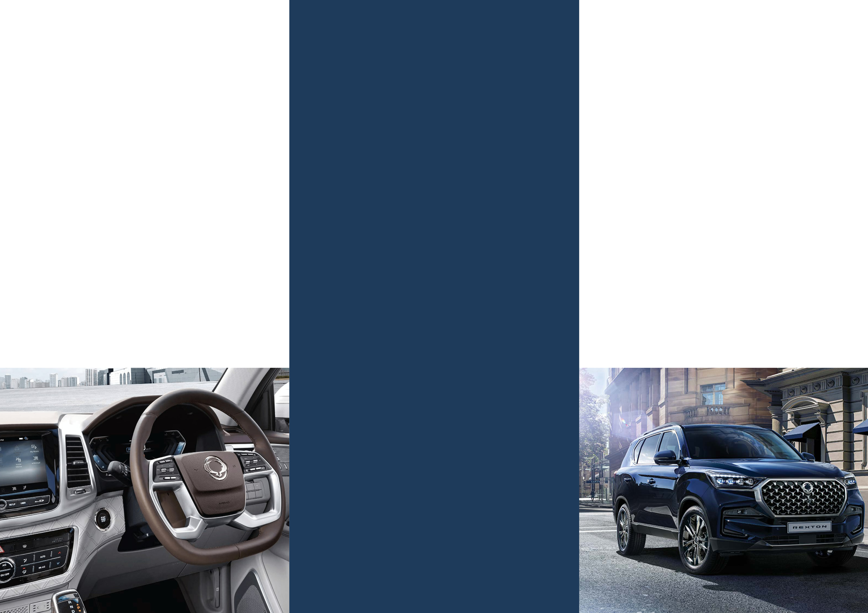
Intro Pack
Protection Pack
Complete Pack
HYDRO Surface Coating
+
XX Dash Camera
HYDRO Complete Pack
+
Window Film
+
Schmick X Year Membership
HYDRO Complete Pack
+
Window Film
+
Schmick X Year Membership
+
XX Dash Camera
$XXXX
$XXXX
$XXXX

