Slide 1
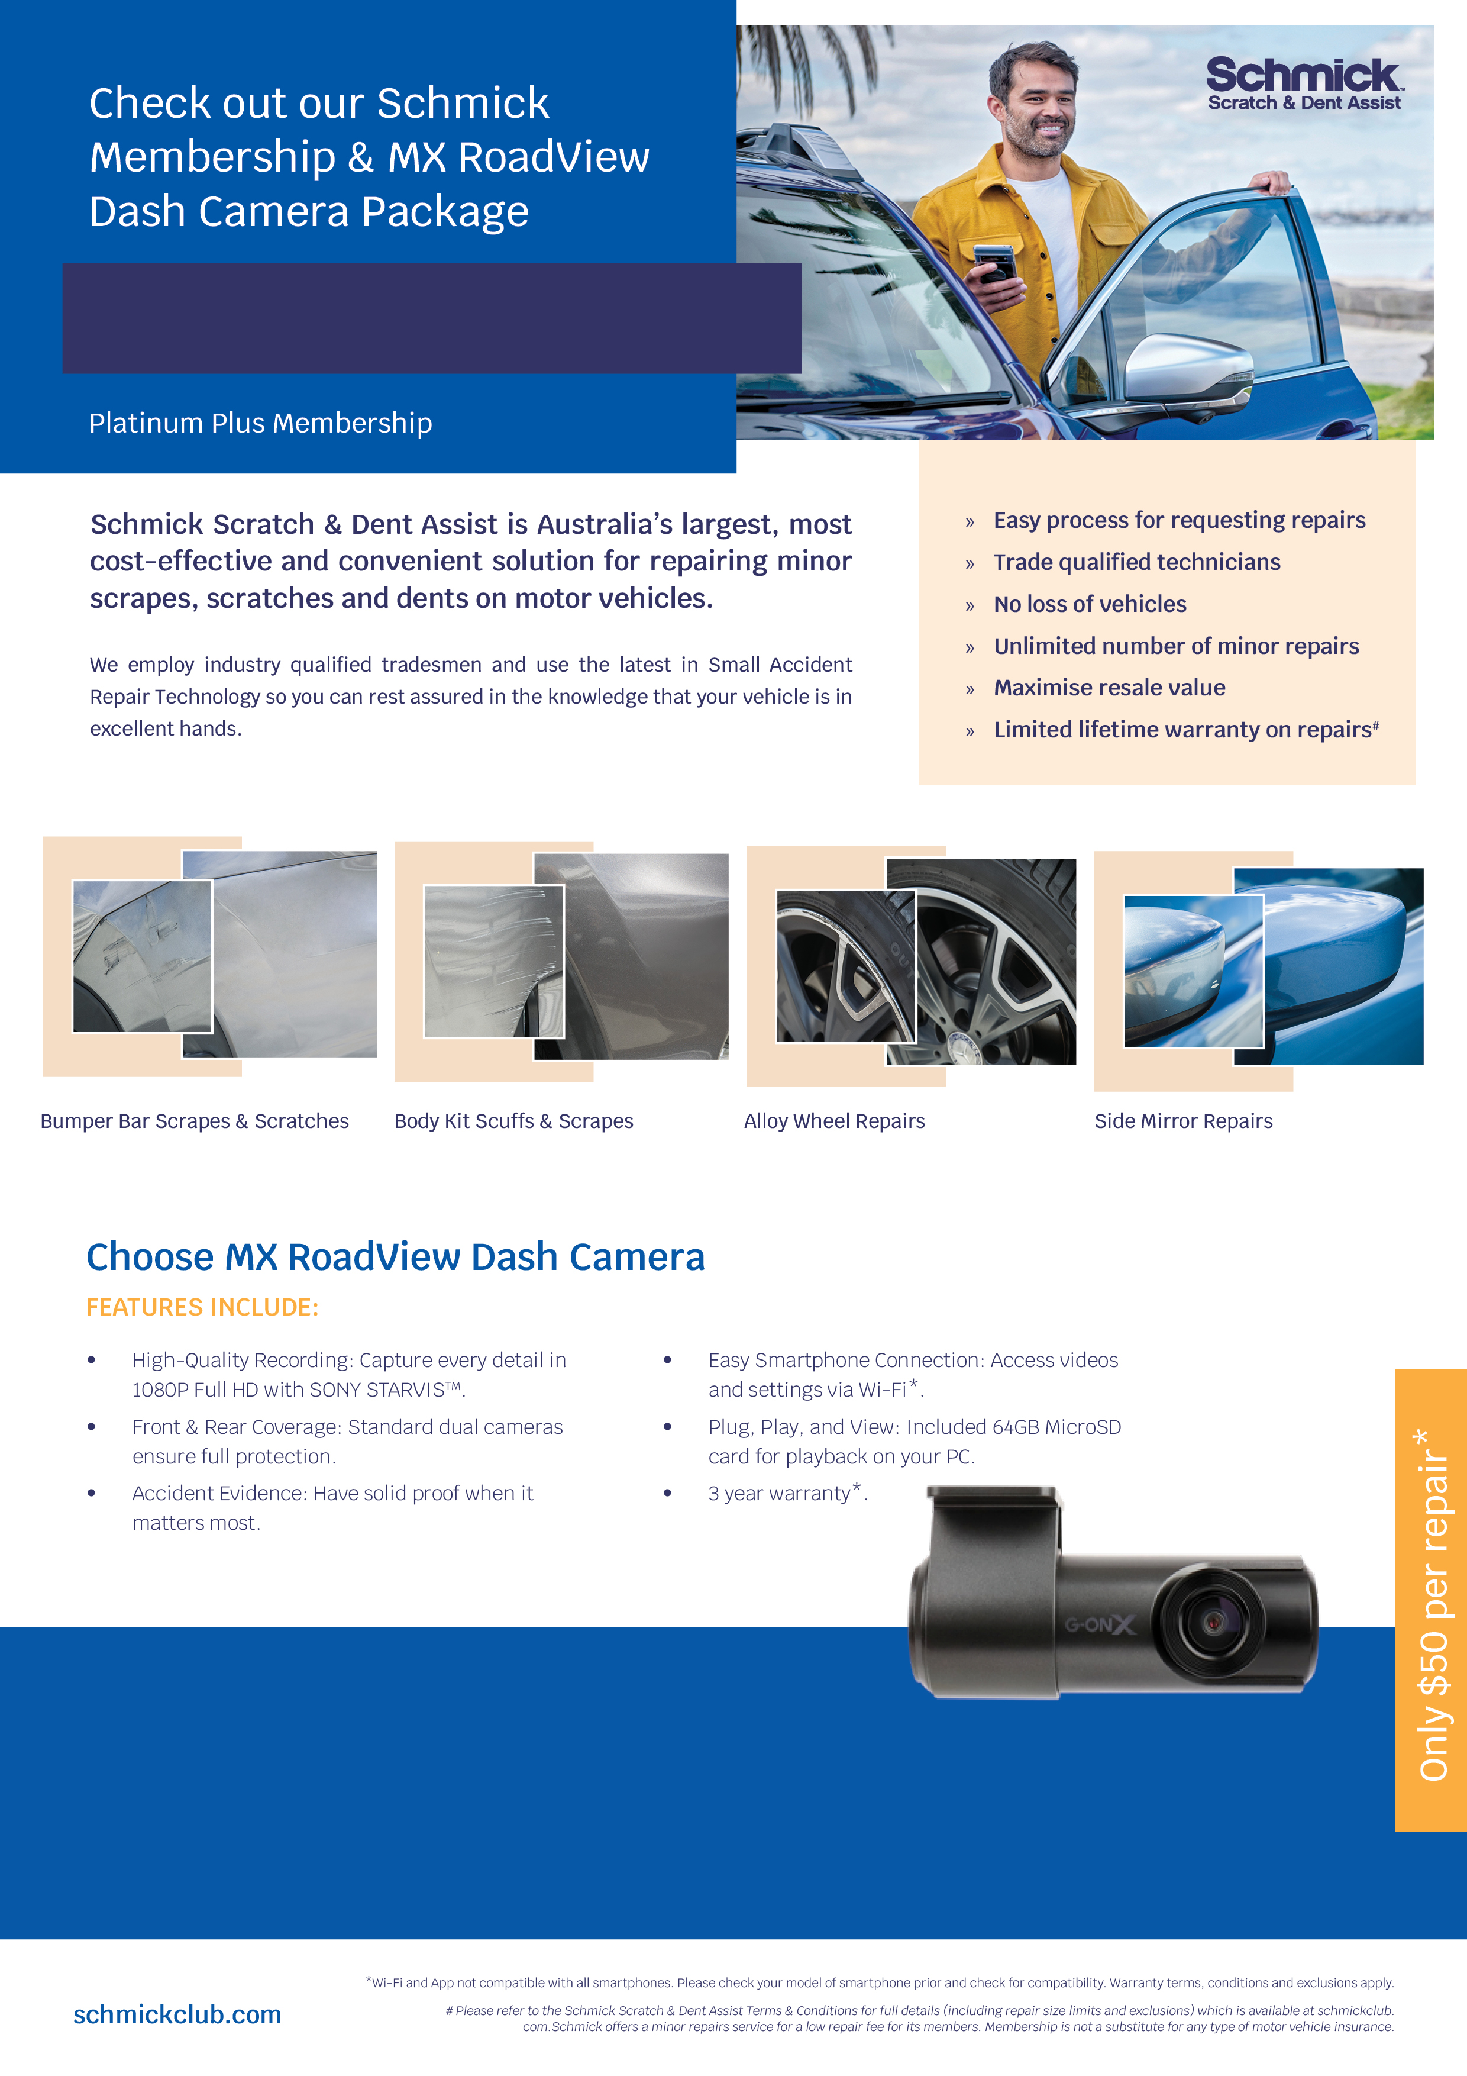
<Special Offer>
Choose our MX Roadview dash camera and get a free 12 month Scratch & Dent Membership
For Only $599.

Slide 2
