Slide 1
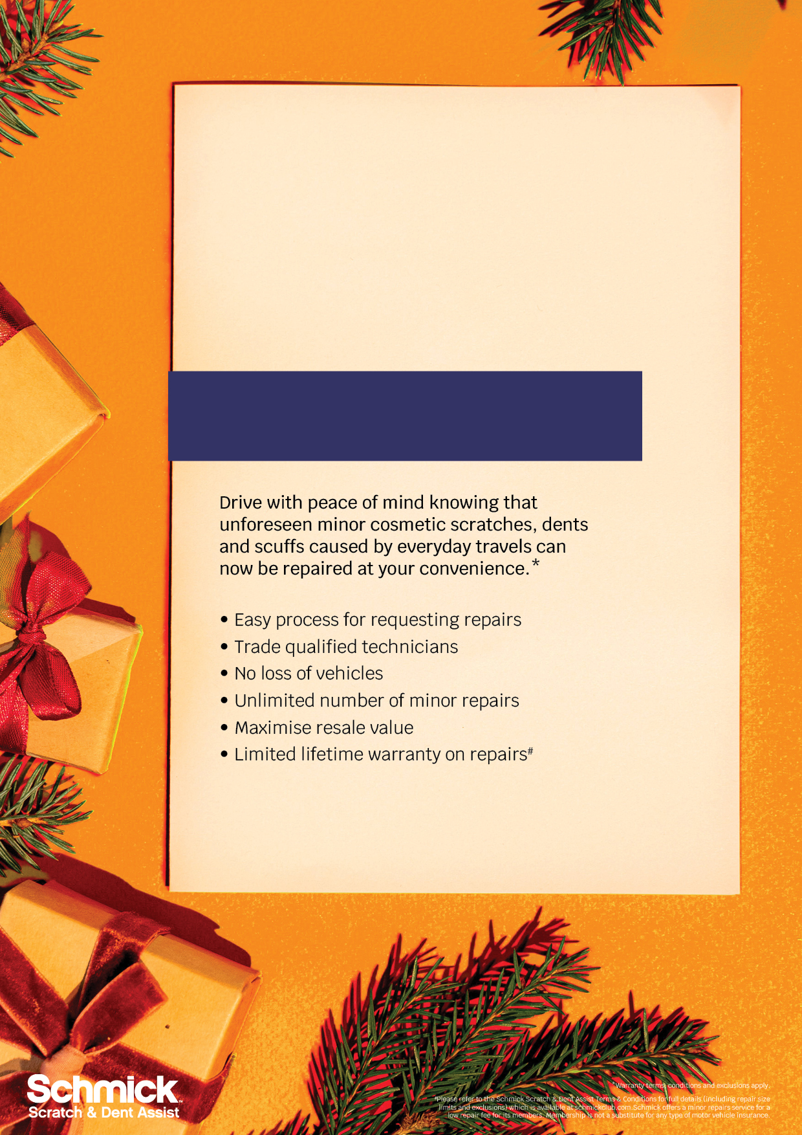
Christmas Special
Exclusive Offer
5 YEAR MEMBERSHIP
JUST $XXX (SAVING OF $XXX)

