Slide 1
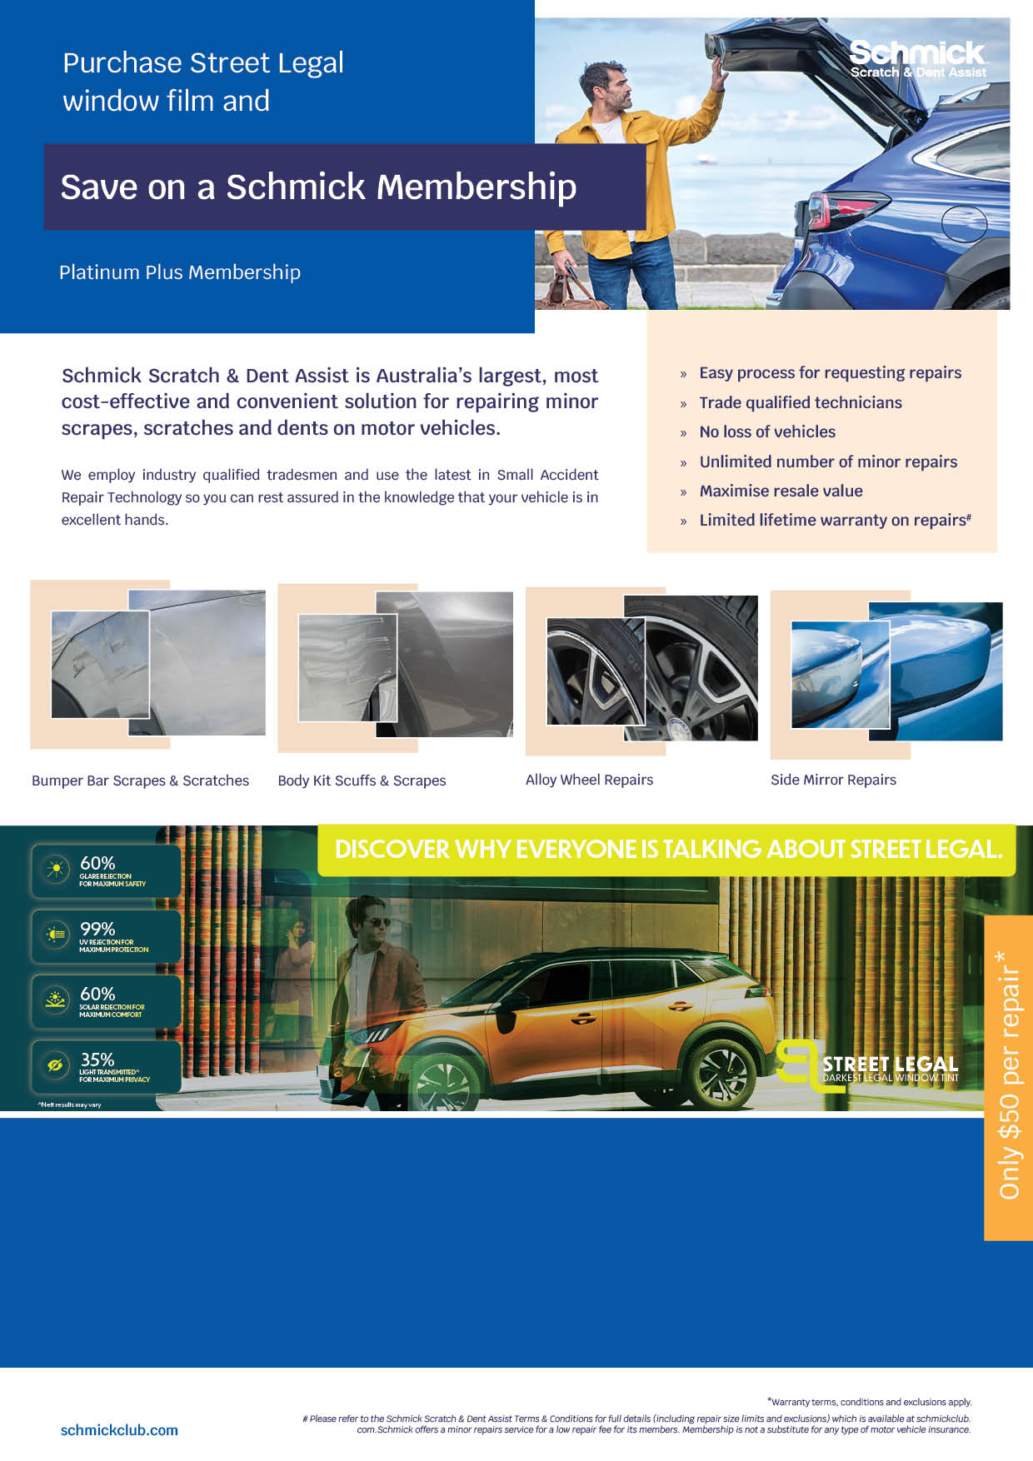
Choice 1
Street Legal Window Film
+
5 Year Schmick Platinum Plus
FOR ONLY $2488
Save $602
Choice 2
Street Legal Window Film
+
3 Year Schmick Platinum Plus
FOR ONLY $1988
Save $502

Slide 2
