Slide 1
Handling Objections
Training Presentation

Slide 2
Handling Objections
“I have had my car for years, and never had any damage”
That’s great that you have looked after your vehicle so well, and you’ve been lucky to avoid any minor dents and scratches. But often, in a brand-new car, it's those small scratches and dents can often occur outside your control, like at busy shopping centre car parks that a Schmick membership can help you with.
There’s nothing more annoying than walking back to your car after doing the shopping to find that someone has accidently pushed a trolley into your side doo, which has left a small pressure dent.
This is a cost-effective solution, to keep your car looking great, and provide you with peace of mind when a third party causes small damage to your vehicle
“I have car Insurance”
Most people only use comprehensive insurance for major events such as Extensive Damage, At Fault Accidents, or Fire & Theft.
Schmick is a cosmetic repair membership that takes care of the minor repairs, which normally fall under the insurance excess value and as such are often left unrepaired. Leaving these unsightly scratches and scrapes to the elements, will obviously devalue your vehicle over time.
Also, comprehensive insurance doesn’t cover alloy wheel damage. An average allow wheel repair can cost anything from $250 to $500 in the market. Having a Schmick membership could save you a lot of money, just in alloy wheel repair expenses

Slide 3
Handling Objections
“I have a friend who is a panel beater”
Is your panel beater able to repair alloy wheels, interior tears or assist with windscreen chips? Panel shops generally use contractors for these kinds of repairs, so it may turn out more expensive in the long run for you.
Roughly 40% of Schmick repair requests are for alloy wheel damage.
Have you also considered, that you will still be without your vehicle for a few days, and you may not be guaranteed a lifetime warranty, should the repair not be satisfactory?
Generally, there is a limit to the number of favours, that one could ask a panel shop mate and people generally find it awkward complaining to mates, if they are not happy with the repair. Plus a “carton of beer, now is generally more than $50”
“I’ll think about”
Ok, that’s great. But may I ask, what you need to think about? Is it the cost, or have I not shown you the value in this membership?
Do you think investing in a membership could provide you with peace of mind, knowing small dents, scratches and damage to your rims, would only cost you $50.00 each to repair?

Slide 4
Handling Objections
“I have to pay for a Membership and then pay per repair… Doesn’t seem worth it”
Yes, similar toa roadside assistance membership, you pay for a membership for peace of mind, that someone will come and “rescue” you. With a Schmick membership, you can repair cosmetic damage on your vehicle in a cost effective and convenient manner.
A 5-year membership costs around $275 per year –that’s less than a dollar a day, and you can have unlimited access to the cosmetic repairs within the guidelines.
To repair half a meter on an alloy wheel corner would cost any where between $500-$1000, plus the inconvenience of being without your vehicle for a few days. But even with the $275 membership for the year, and one bumper repair, that’s only $325 –saving around $650 just for one repair.
“I have already spent too much extra on buying this car”
I understand it seems like a big investment up front, but unlike your comprehensive car insurance, this is only one payment that works out to be around $275 per year, for 5yrs membership. If you are financing with us, it will have minimal impact on your repayments. (If BM can quote the difference upfront, If Consultant, ask BM to calculate payment with and without)
Many members see the value early on in the membership, as they have had to have dents removed from their new car, that occurred in busy car parks, or have clipped their alloy wheel, going through a narrow drive through. These damages are quite expensive to be repaired, but with this membership the cost is only $50 for each repair requested.

Slide 5
Handling Objections
“If I can’t have it with my finance, I don’t want it”
The great thing about the Schmick membership is that it is fully transferable and flexible. So if you decide to trade up earlier than the term of your loan, it is easy to transfer to your new car. Or, if you sell this vehicle, and are not replacing it, you can transfer to your partner/kids car, provided it is newer in age.
Because of this, we don’t tie it up with your finance loan , to allow for easy transfer and flexibility, we can just take a credit card payment with one or two instalments, or we can do for roughly $... Per month on Humm(or equivalent).
Note:
If a deposit is being refunded, and it’s not required for finance approval you could suggest you take it from the debit/credit card that deposit is being refunded to or just not refund the deposit and re-invest in a membership.
Look to obtain finance approval without using deposit and then use the above. This also helps increase overall NAF.

Slide 6
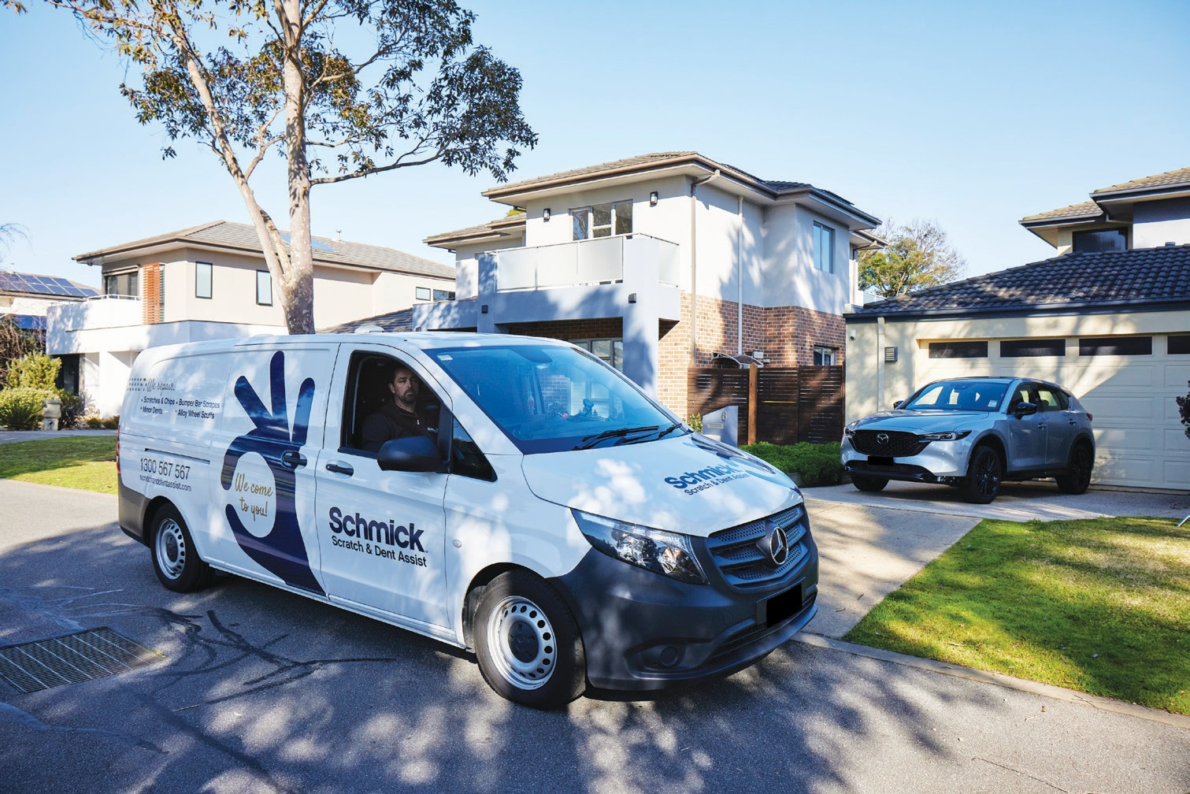
Member Benefits
A low price of $50 per repair (withing the guidelines)
Unlimited number of repairs
Convenient on-site service –Driveway and Access to Power
Unique mobile app allows members to lodge a repair request and upload photos of the damaged area
Convenient repairs booking process via our centralised customer service team
Avoid claiming on insurance for minor repairs (no excess or possible affect on no claim bonus)
All repairs backed by our Lifetime Warranty (as long as customer owns the nominated vehicle)
Fully Transferable - Membership can be transferred to a new vehicle in the member’s name provided that the new vehicle is not older than the existing nominated vehicle or to the new owner of the original nominated vehicle

Slide 7
What our customers are saying
4.7 Star Rating (out of 1400+ reviews!)
Michelle To
So happy we joined Schmick car care club, we have already used it a few times and got our money’s worth! Service was always friendly and helpful, most importantly repair works were done to perfection. Highly recommend especially for new cars.
Janakiram Meesala
Mike repaired the curb rash on 3wheels on Jaguar. What an amazing skill. Very professionally done and attention to detail. Very happy. :)
Karthik Vedula
Shawn has attended to repair a small dent on my recently purchased BMW. The dent was difficult to remove as it was just underneath the style line. I cannot recommend him enough, he was very professional through out the process and also explained to me what he was doing. He did an excellent job.
Keep up the amazing work guys!!
Karen Hope
Daniel arrived on time to repair the rim rash on my alloy wheel. He was polite, professional and efficient. The wheel looks brand new. Great service. Highly recommend, certainly worth the membership for your vehicle.

