Slide 1







Training Overview
March 2023

Slide 2
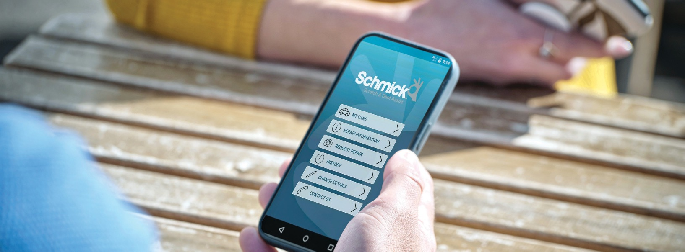
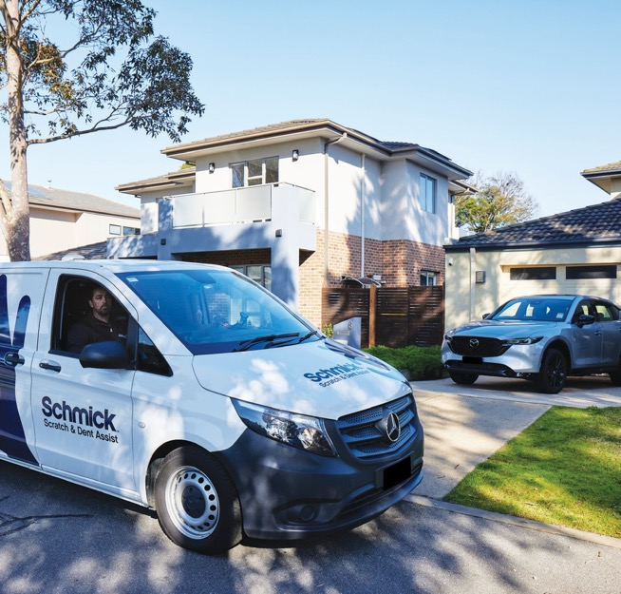

Watch our Repair Video!
Learn our easy repair process.
Watch our repair video!
Scan Here to Download our
repair video
If you’re having trouble viewing this video, watch it on YouTube: https://youtu.be/gWJziYiU29o

Slide 3
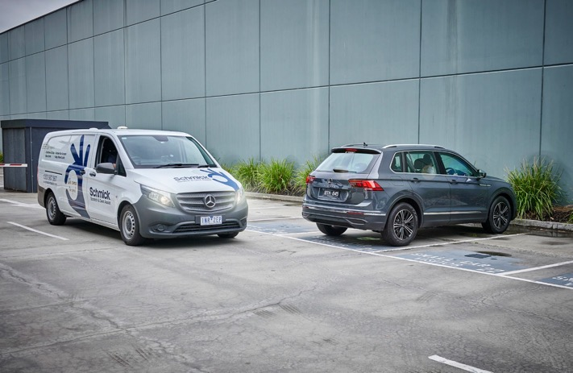
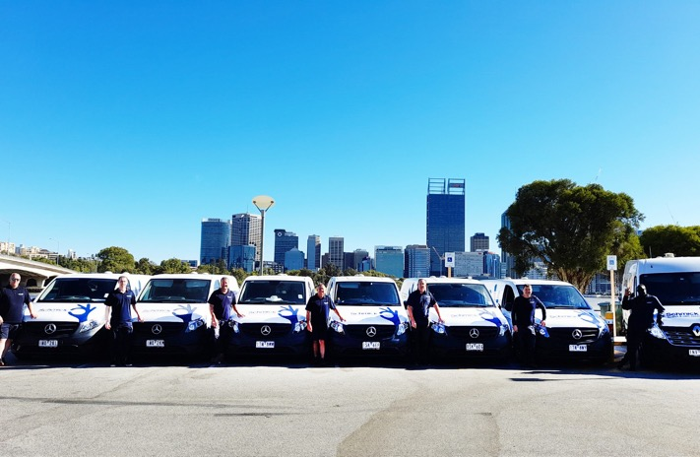

Schmick Scratch & Dent Assist
- An Overview
The Schmick Membership program is similar to ‘roadside assitance’ that assists in keeping your customer new car looking “NEW!” by carrying out unlimited minor cosmetic repairs.
Your Customers who purchase a vehicle up to 7 years old are eligible to join our Platinum Plus membership for 1 to 5 years.
Commenced operation in 2010 – Schmick has the longest trading history and most experience in Scratch & Dent memberships. Over this time, we have built an outstanding reputation on delivering on our promise.
Schmick is continually expanding, and has a fleet of over 75 customised repair vans nationally. We operate in all states.
Owned by the MotorOne Group. MotorOne have been in operation for circa 40 years.
Schmick provides a great profit opportunity for dealerships and great value for customers.
WA Vans & Technicians
including specialised wheel repair van

Slide 4

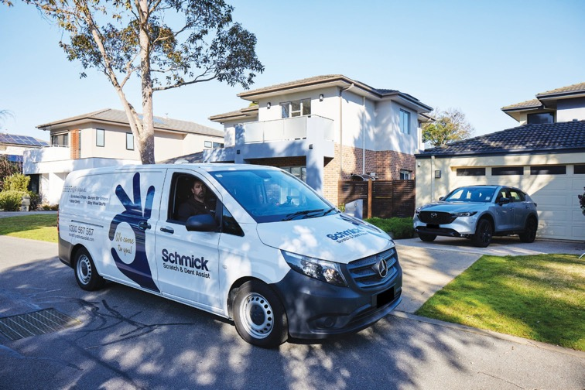

Member Benefits
A low price of $50 per repair (withing the guidelines)
Unlimited number of repairs
Convenient on-site service – Driveway and Access to Power
Unique mobile app allows members to lodge a repair request and upload photos of the damaged area
Convenient repairs booking process via our centralised customer service team
Avoid claiming on insurance for minor repairs (no excess or possible affect on no claim bonus)
All repairs backed by our Lifetime Warranty (as long as customer owns the nominated vehicle)
Fully Transferable -Membership can be transferred to a new vehicle in the member’s name provided that the new vehicle is not older than the existing nominated vehicle or to the new owner of the original nominated vehicle

Slide 5
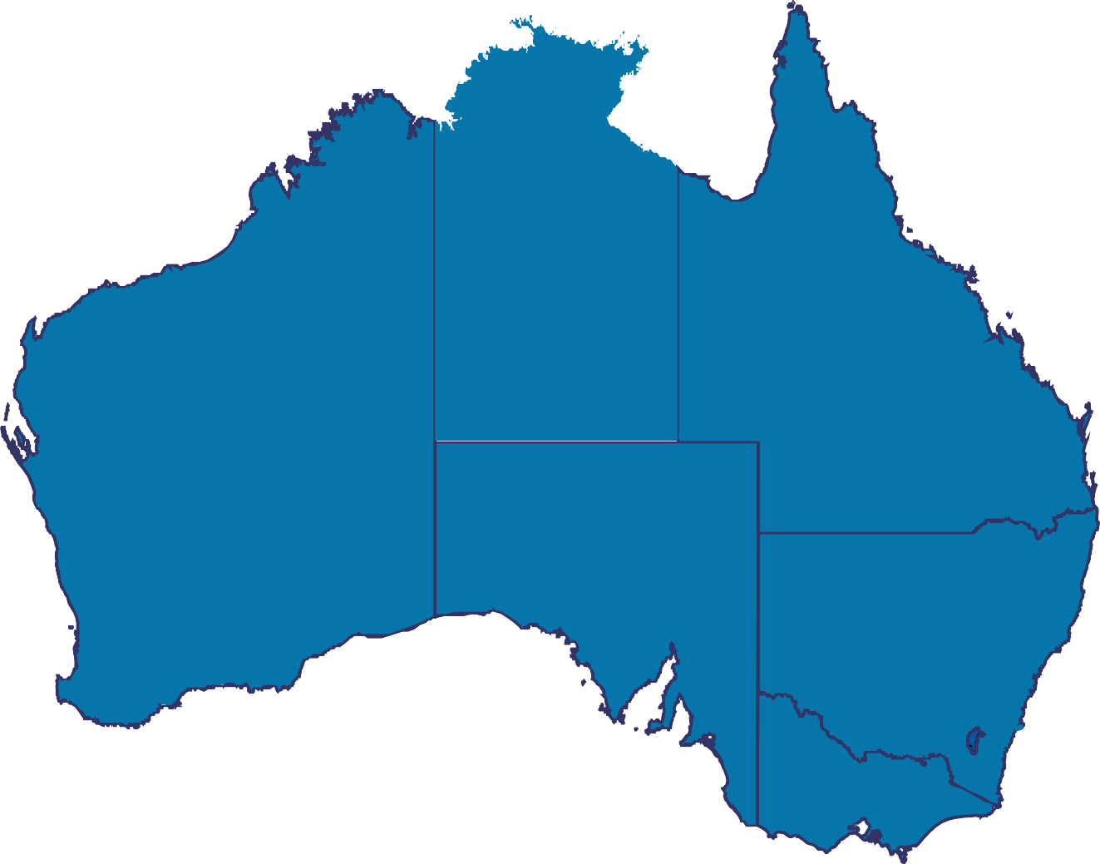

National Coverage
Schmick offers the most comprehensive repair program in Australia, providing coverage to the greater metropolitan areas in each state and some regional centres, via both mobile repair vans and fixed repair centres. Additional benefit of access to the MotorOne Autobody repair network, for out of scope repairs.
Queensland
Brisbane Gold Coast Toowoomba Cairns Townsville
Sunshine Coast (F) Brendale (F) Acacia Ridge (F)
Harvey Bay
Bundaberg
South Australia
Adelaide
Port Wakefield Victor Harbour Murray Bridge
Tasmania
Hobart Launceston Devonport
Western Australia
Perth Bunbury Two Rocks Northam
Northen Territory
Queensland
New South Wales
Sydney Newcastle Central Coast Northern Rivers Wollongong Eastern Creek (F) Penrith (F)
Western Australia
Brisbane
South Australia
Perth
New South Wales
Australian Capital Territory
Canberra
Adelaide
Sydney
Canberra
Victoria
Melbourne Ballarat Bendigo
Albury/ Wodonga Lakes Entrance Geelong (F) Maidstone (F) Wantirna (F) Dandenong (F) Melton (F)
Melbourne
Hobart
(F) denotes fixed repair centre locations

Slide 6
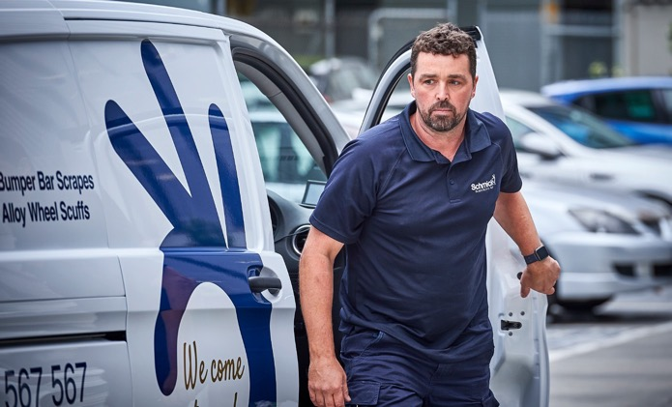
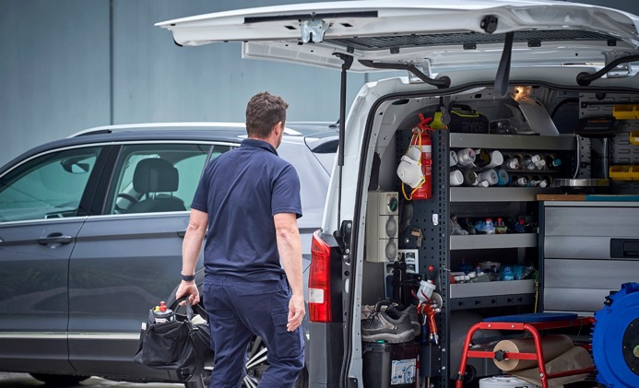
Our Schmick Technicians
All technicians undergo the Schmick Quality Training Program and must be trade qualified.
Arrive at the repair destination in the Schmick repair vehicle which is fully fitted with state-of-the art repair equipment.
For customer’s peace of mind, all technicians wear the Schmick uniform
Continual training in both customer service and keeping abreast of new techniques in cosmetic repairs

Slide 7
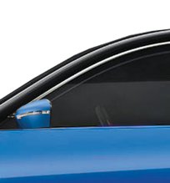
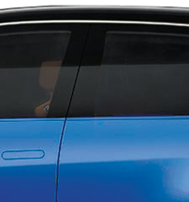
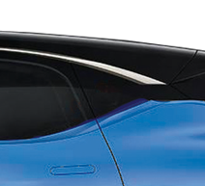
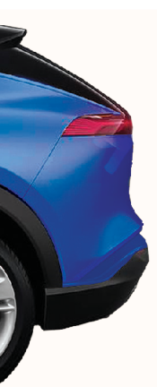
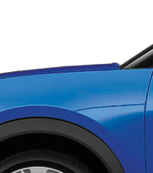
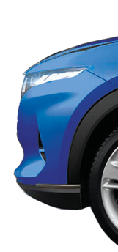
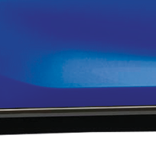
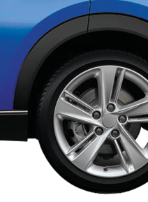
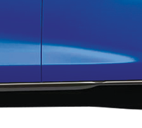
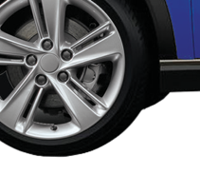
Repairs Guide Overview#
Only $50 per repair*
Quick, easy and
Interior Sanitisation Treatment
Interior Leather & Vinyl Tears
Up to 80mm
convenient repairs.
Mirror Casing Scuffs & Scrapes
No size limits
Surface Marks & Scratches
Covering up to 4 panels
Pressure Dent
Up to 60mm
Windscreen Chips
1 stone chip up to 20mm (5mm in Critical Vision Area)
Stone Chips
Up to 30 cosmetic touch ups
Plastic Body
Bumper Bar Scuffs & Scrapes
Up to 500mm
Kit Scuffs & Scrapes
Up to 500mm
Deep Scratch on Vertical Panel
Alloy Wheel Scuffs & Scrapes
No size limits
Up to 60mm
FREE TOUCH UP of up to 5 stone chips
with any other paint repair completed
OR
FREE BUFF & POLISH of 1 area
with any other paint repair completed
* Repair fee for a single repair at time of printing. Subject to change. Refer to schmickclub.com for repair fee applicable at the time of requesting a repair.
# Please refer to the Schmick Scratch & Dent Assist Terms & Conditions for full details (including repair size limits and exclusions) which is available at schmickclub.com.Schmick offers a minor repairs service for a low repair fee for its
members. Membership is not a substitute for any type of motor vehicle insurance.
Key Exclusions
Chrome and high polished alloy wheels · Replacement parts · Structural damage · Style line dents · Non painted textured plastic components
· Damage on your vehicle prior to joining Schmick · Deep panel scratches on roof, bonnet, tailgate and boot.

Slide 8
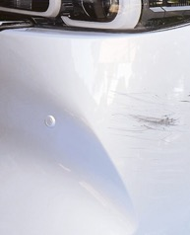
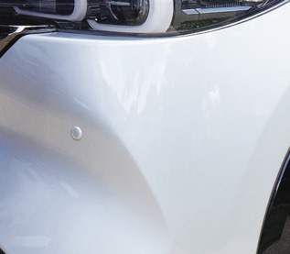
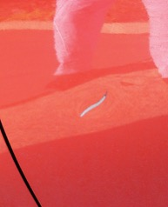
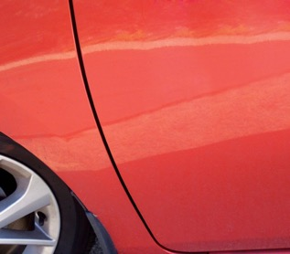
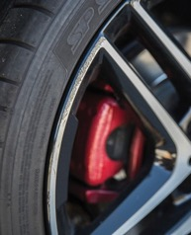
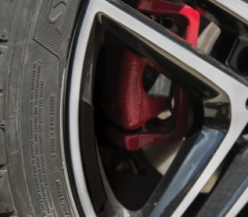
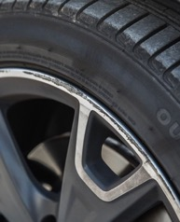
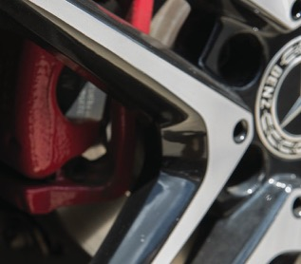
Included Repairs
$50 per repair*
Bumper Bar/ Body Kit Scrapes & Scratches
Up to 500mm in length on front and back bumpers
Deep Panel Scratch or Dent with Paint Damage
1 x only scratch or dent- up to 60mm in length or diameter on a vertical panel (Excludes roof, bonnet, tailgate and boot)
Alloy Wheel Scrapes -
Scuffs and Scrapes on one alloy wheel – no size limit
(Excludes chrome and high polished wheels or damage to a pin stripe)

Slide 9
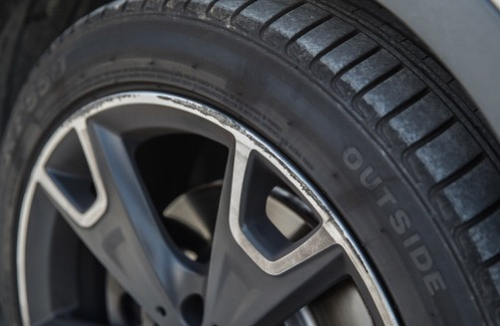
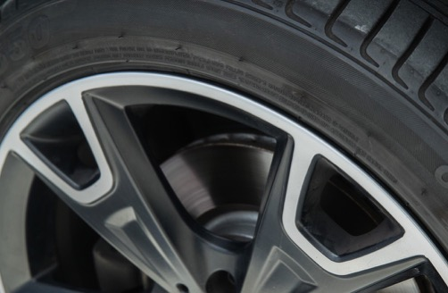
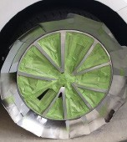
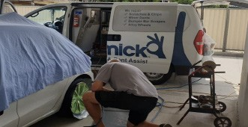
 | Alloy Wheel
Repair Process Scuffs and Scrapes on one alloy wheel – no size limit. Includes machine finished wheels/ painted alloys (Excludes chrome and high polished/ reflective wheels or damage to a pin stripe)
Before
After
Repair Process

Slide 10
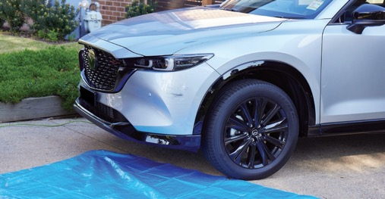
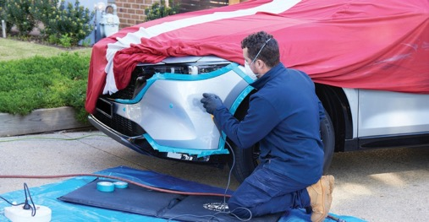
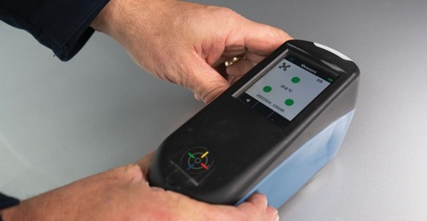
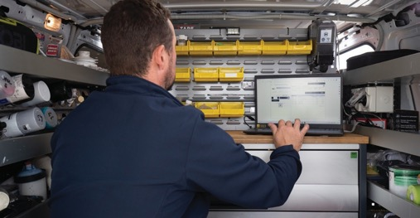
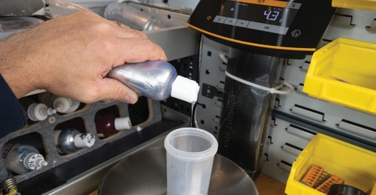
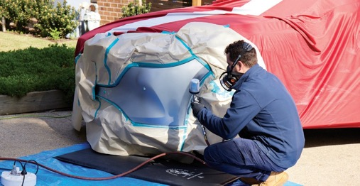
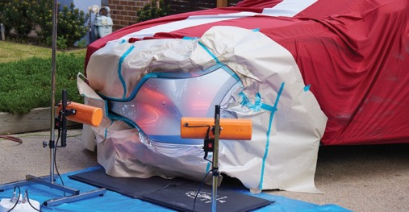
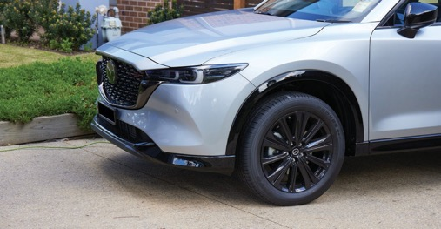
 | Bumper Repair
Process
1.
2.
3.
4.
5.
6.
7. 8.
1. Vehicle before repair 2. Preparing damaged area 3. Spectrophotometer analyses paint colour 4. Technician looks up paint formula
5. Exactly measures & mixes paint 6. Technician resprays damaged area 7. Infrared lights bake the paint 8. Vehicle repair is complete.

Slide 11
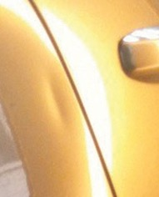
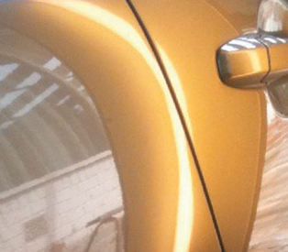
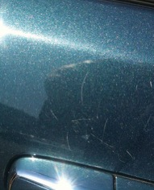
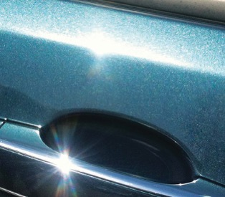
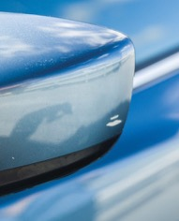
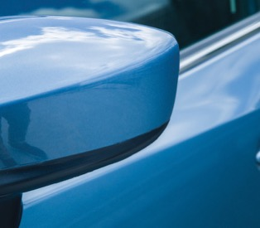
Included repairs.
Only $50 per repair*
Pressure Dents
Up to 60mm in diameter on all flat metal panels (Excludes dents on style lines & metal folds)
Surface Scratches & Marks
Covering up to 4 painted panels
Side Mirror Scrapes & Scratches
Covering one plastic painted mirror casing - no size limit (Excludes chrome finished casing)

Slide 12
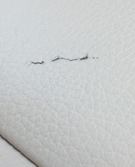
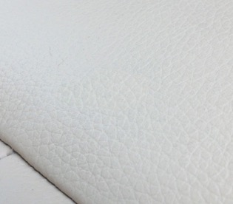
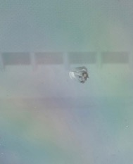
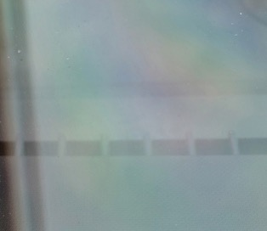
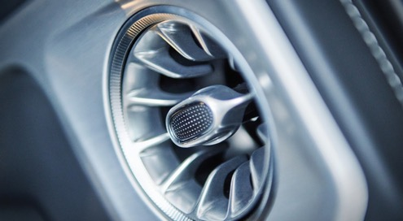
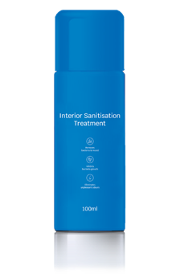
Included repairs.
Only $50 per repair*
Interior Leather & Vinyl Repairs
Tears up to 80mm in length on seats or armrest
Windscreen Repairs
1 Stone Chip up to 20mm (5mm in Critical Vision Area)
Interior Sanitisation Treatment
Protect your family’s health against infectious viruses and bacteria with a Schmick Interior Sanitisation Treatment

Slide 13

Establishing a suitable workspace for repairs.
Access to power within 20 metres
Garage, carport or private driveway
No vehicle parked directly in front, beside or behind your vehicle
Minimum 3 metres clear beside the vehicles damaged area.
Schmick are unable to complete paint repairs for the following locations:
Undercover car parks or ground level body corporate car parks
On street parking
Wash bays or detailing bays
Bookings can be made between Monday and Friday, excluding public holidays. If customers do not have a suitable work- space, we would suggest trying to arrange a location with a friend or family member.

Slide 14
Other Memberships Available
Trade Membership
For Trade/ Business Use
3 year membership
Available on Utes and Vans used exclusively for business use
Repairs are $90 per repair
7 Year Membership
For Financing Customers
7 year membership
Available for customer who are financing their car over a 7 year loan
Should not be offered to non-finance customers or customers with 5 years or less loans.

Slide 15
Main Product Exclusions
Pre-existing damage
Replacement parts
Repair of deep scratches on roofs, bonnet, boot lid and tailgate
Chrome & high polished/reflective finish & pin stripe damage on wheels
Metal, chrome finished bumper bars
Any component that can’t be painted (ie. Non colour coded moulded plastic parts, textured plastic, chrome parts etc)
Dents to style lines and metal folds
Hail damage
Memberships not available on supercars ( Eg. Bentley, Ferrari, Maserati, Aston Martin etc)
Excluded from Membership
Hire Car Service and Taxi Services

Slide 16

Requesting a repair
An Easy Process to Book a Repair
The ability for members to quickly and easily take a photo of damage and send a repair request at the click of a button.
Member receives response confirming request logged along with additional helpful information.
Members can change their personal details including change of address and phone number.
Compatible with both Android and Apple smartphones.
Customers have 3 options
to request a repair:
Through the Schmick dedicated App.
By email direct to national call centre.
By phone direct to national call centre.
Please ensure customer understands each repair is $50, for example: when taking a photo of a wheel and a bumper it will be $100 in total

Slide 17




How to Process a Membership

Slide 18


How to Process a Membership

Slide 19
Customer Acknowledgement Form
Business Name (if applicable): |  | Vehicle Registration:
Contact First Name: |  | Contract Last Name:
Address:
I, acknowledge and agree that I:
am the individual identified above;
have received a full copy of the Schmick membership terms and conditions and understand that I have 7 days to read and understand them during which time I am eligible for a full refund;
have been advised:
  of the full cost of membership (and that where payment for the Schmick membership is financed, interest will be applicable to the advised cost of the Schmick membership);
  no refund is available if I wish to cancel the Schmick membership after the first seven (7) days from the Start Date of the Schmick membership;
  of the limitations for transferring the Schmick membership to a different vehicle or owner;
  of the key exclusions for damage including, but not limited to, deep scratches on the roof, bonnet and boot lid of vehicle (noting this does not exclude pressure dents and surface scratches on these areas)
  that the current repair fee of $50.00 is not fixed for the membership term and is subject to change at Schmick’s discretion;
  that geographic region conditions and ‘service area’ conditions apply that may impact on the ability to obtain repairs under the Schmick membership (including the requirement for 2 metres clearance around the area of the vehicle to be repaired, access to electricity and that repairs cannot be completed in a publ ic road/ underground carpark)
Signature:
Date:

Slide 20





What our customers are saying
4.7 Star Rating (out of 1400+ reviews!)
Michelle To
So happy we joined Schmick car care club, we have already used it a few times and got our money’s worth! Service was always friendly and helpful, most importantly repair works were done to perfection. Highly recommend especially for new cars.
Janakiram Meesala
Mike repaired the curb rash on 3wheels on Jaguar. What an amazing skill. Very professionally done and attention to detail. Very happy. :)
Karthik Vedula
Shawn has attended to repair a small dent on my recently purchased BMW. The dent was difficult to remove as it was just underneath the style line. I cannot recommend him enough, he was very professional through out the process and also explained to me what he was doing. He did an excellent job.
Keep up the amazing work guys!!
Karen Hope
Daniel arrived on time to repair the rim rash on my alloy wheel. He was polite, professional and efficient. The wheel looks brand new. Great service. Highly recommend, certainly worth the membership for your vehicle.

Slide 21

For more information
get in touch with:
Kerry Richards
National Product Manager
0448 005 932
kerry@schmickclub.com

