Slide 1
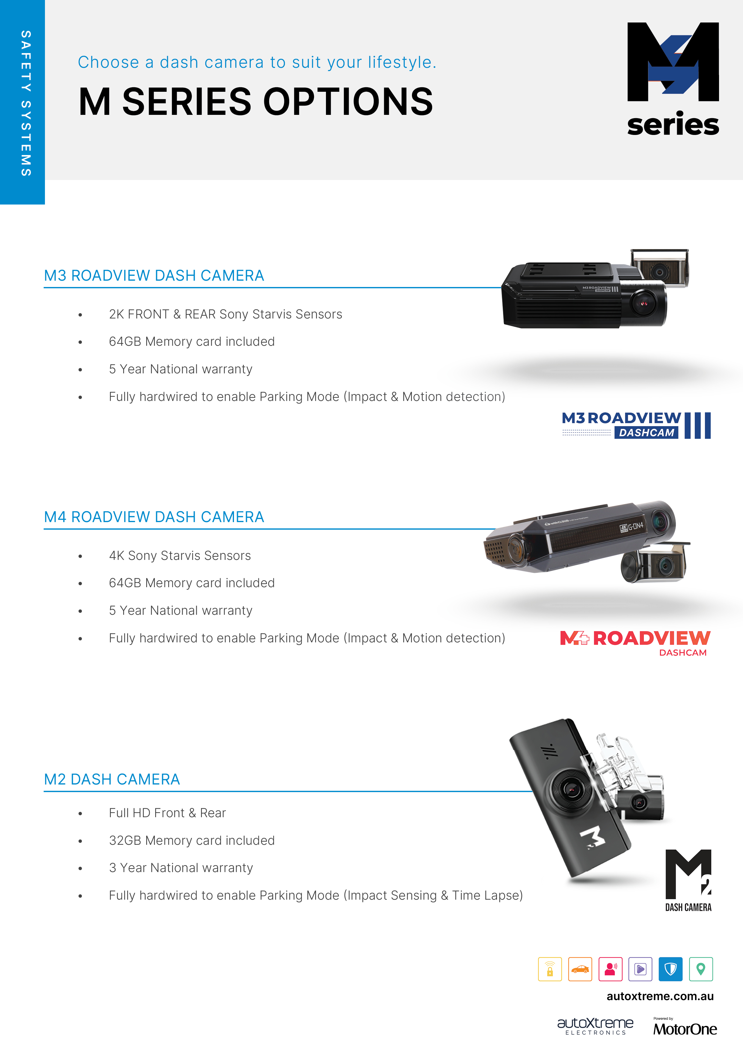
<insert dealer logo>
<insert contact information>

Slide 2
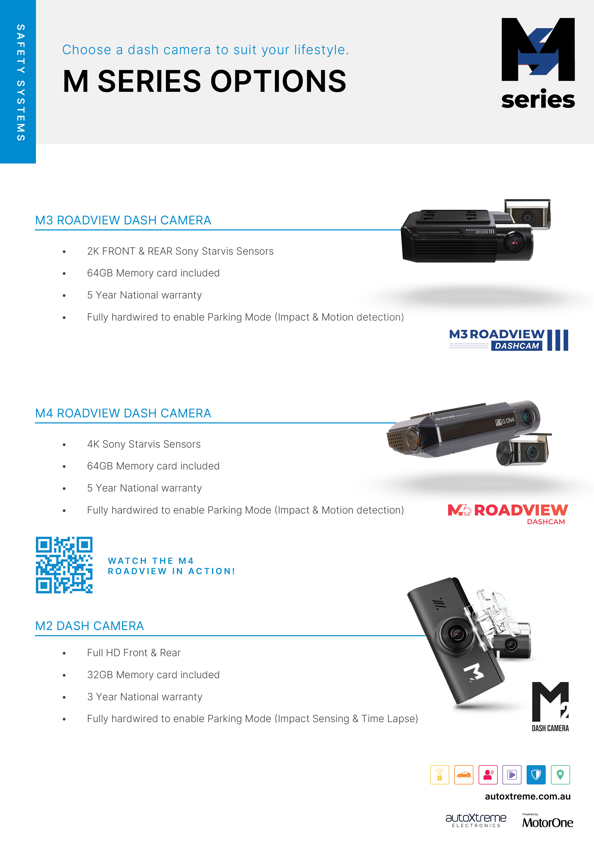
<insert dealer logo>
<insert contact information>

