Slide 1
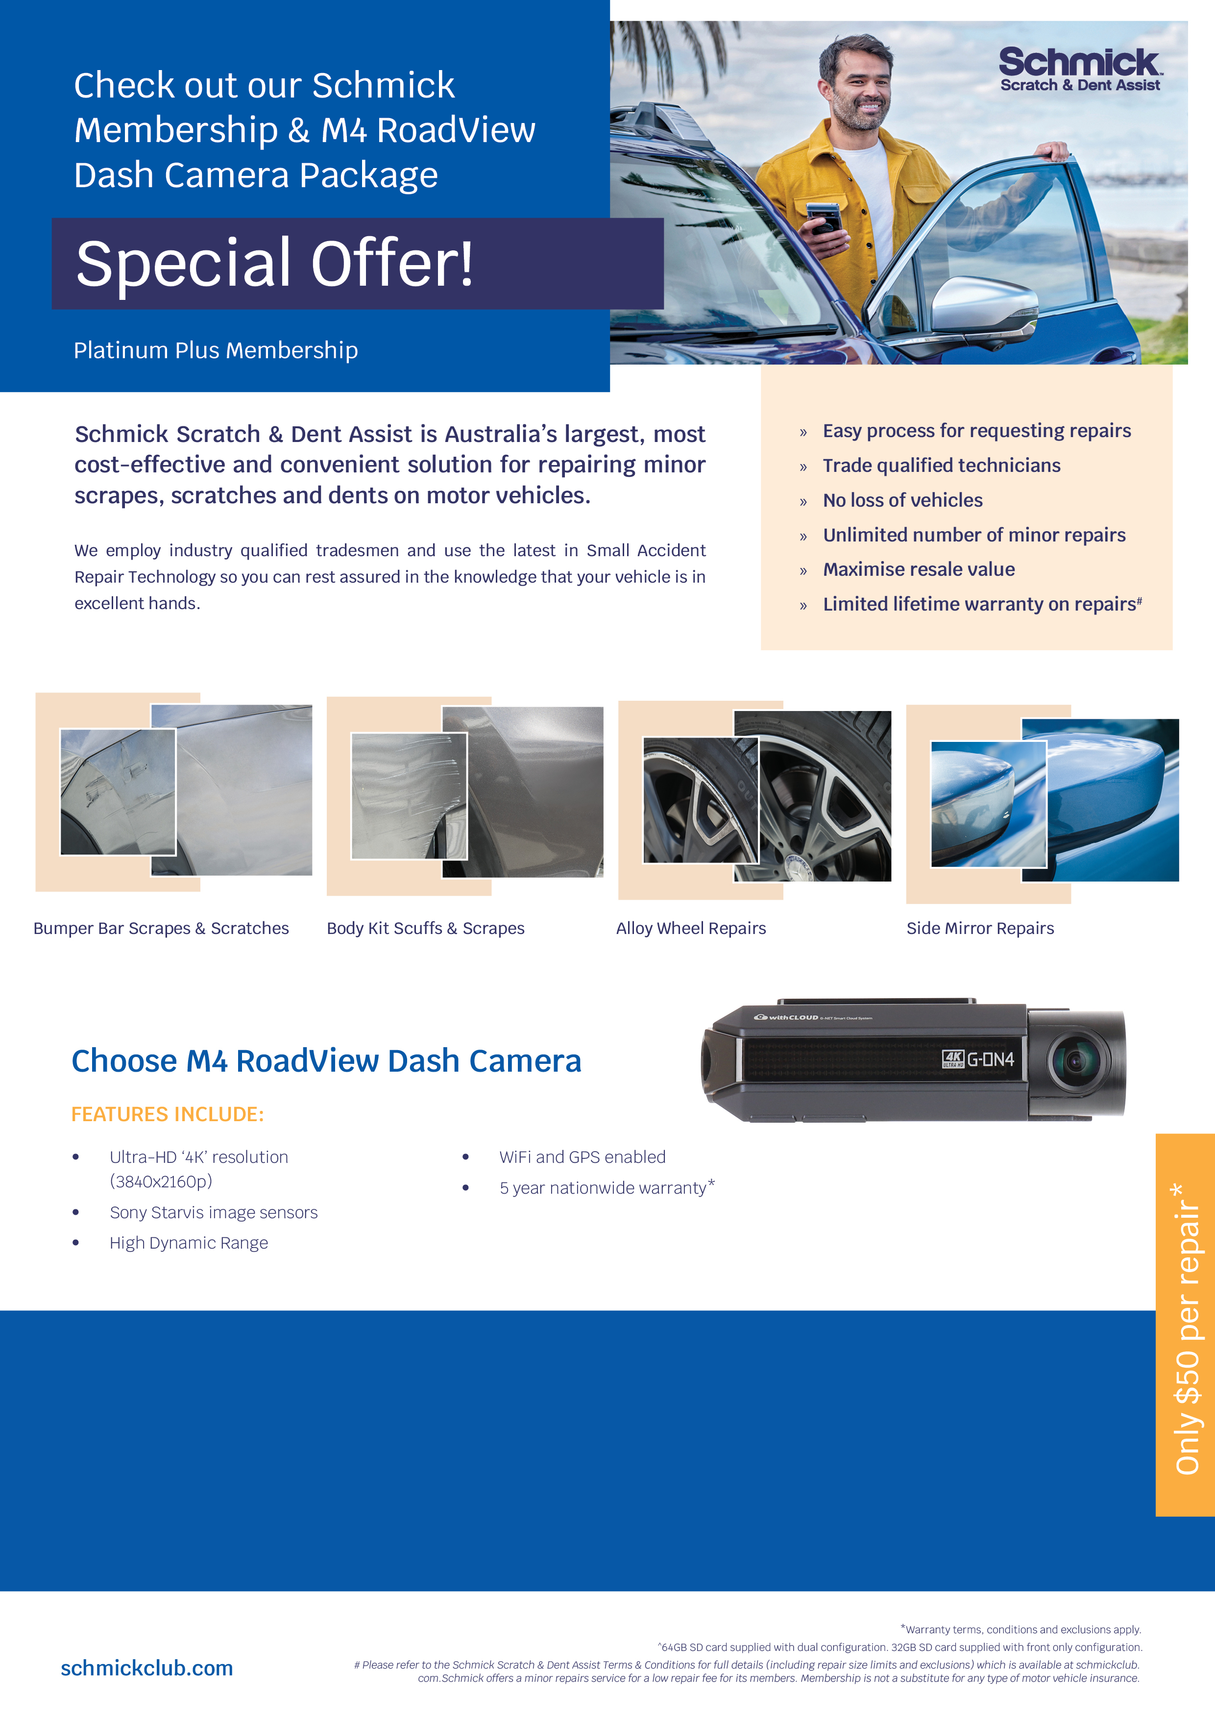
Choice 1
M4 RoadView Dash Camera
+
5 Year Schmick Platinum Plus
FOR ONLY $XXXX
Save $XXX
Choice 2
M4 RoadView Dash Camera
+
3 Year Schmick Platinum Plus
FOR ONLY $XXXX
Save $XXX

Slide 2
